Slide 1
Types of Chemical Reactions
Combustion
Synthesis
Decomposition
Single Replacement (Displacement)
Double Replacement (Displacement)
Acid-Base

Slide 2
Combustion
A combustion reaction is when oxygen combines with another compound to form water and carbon dioxide.
These reactions are exothermic, meaning they produce heat.
For example the burning of napthalene:
C₁₀H₈ + O₂ → CO2 + H₂O

Slide 3
Synthesis
A synthesis reaction is when two or more simple compounds combine to form a more complicated one.
These reactions come in the general form of:
A + B → AB
For example iron and oxygen combine to yield iron (III) oxide: (write the equation)
4Fe + 3O₂ → 2Fe₂O₃

Slide 4
Decomposition
A decomposition reaction is the opposite of a synthesis reaction - a complex molecule breaks down to make simpler ones.
These reactions come in the general form:
AB → A + B
For example the electrolysis of water to make oxygen and hydrogen gas:
(write the formula)
2 H₂O →2 H₂ + O₂

Slide 5
Single displacement
This is when one element trades places with another element in a compound.
These reactions come in the general form of:
A + BC → AC + B
For example magnesium replaces hydrogen in water to make magnesium hydroxide and hydrogen gas: (write the formula)
Mg + 2H₂O → Mg(OH)₂ + H₂

Slide 6
Double displacement
The anions and cations of two different molecules switch places, forming two entirely different compounds.
These reactions are in the general form:
AB + CD → AD + CB
For example the reaction of lead (II) nitrate with potassium iodide to form lead (II) iodide and potassium nitrate: (All ppt reactions are DD/DR)
Pb(NO₃)₂ + 2KI → PbI₂ + 2KNO₃

Slide 7
Acid-base
This is a special kind of double displacement reaction that takes place when an acid and base react with each other.
The H⁺ ion in the acid reacts with the OH⁻ ion in the base, causing the formation of water.
Generally, the product of this reaction is some ionic salt and water:
HA + BOH → BA + H₂O

Slide 8
Acid-base
One example of an acid-base reaction is the reaction of hydrochloric acid with sodium hydroxide:
(write the equation)
HCl + NaOH ---> NaCl + H₂O

Slide 9
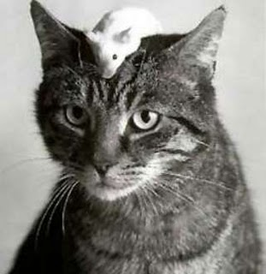
Questions?

Slide 10
Sample Problems
1) NaOH + KNO₃ → NaNO₃ + KOH
double displacement
2) CH₄ + 2 O₂ → CO₂ + 2 H₂O
combustion
3) 2 Fe + 6 NaBr → 2 FeBr₃ + 6 Na
single displacement
4) CaSO₄ + Mg(OH)₂ → Ca(OH)₂ + MgSO₄
double displacement
5) NH₄OH + HBr → H₂O + NH₄Br
acid-base
6) Pb + O₂ → PbO₂
synthesis
7) Na₂CO₃ → Na₂O + CO₂
decomposition

