Slide 1
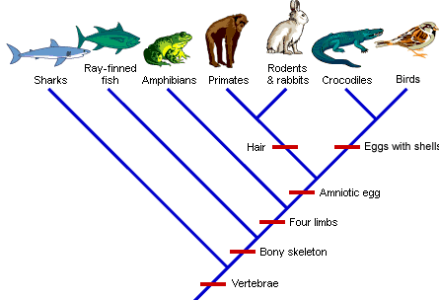
Topic 5.4: Cladistics

Slide 2
Cladistics
Cladistics is the identification of clades and construction of cladograms.
Clades are nested within one another — they form a nested hierarchy. A clade may include many thousands of species or just a few. Some examples of clades at different levels are marked on these phylogenies. Notice how clades are nested within larger clades.
http://evolution.berkeley.edu/evolibrary/search/imagedetail.php?id=261&topic_id=&keywords=

Slide 3
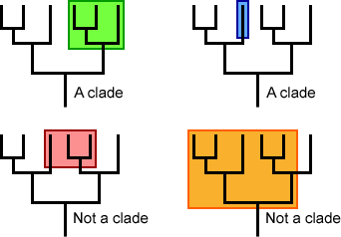
Clades
A clade is a group of organisms that have evolved from a common ancestor (includes common ancestor and all descendants)

Slide 4
Essential idea: The ancestry of groups of species can be deduced by comparing their base or amino acid sequences.

Slide 5
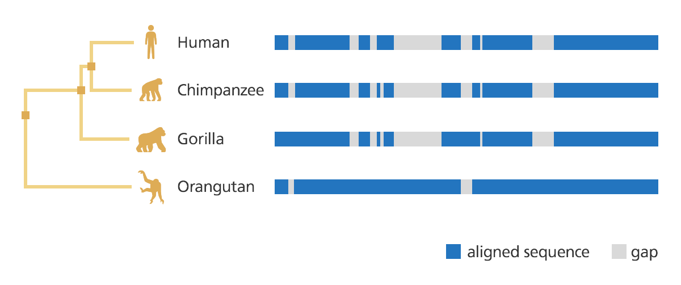
Evidence for which species are part of a clade can be obtained from the base sequences of a gene or the corresponding amino acid sequence of a protein.
Sequence differences accumulate gradually so there is a positive correlation between the number of differences between two species and the time since they diverged from a common ancestor.

Slide 6
Cladograms
tree diagrams that show the most probable sequence of divergence in clades.
Branch points are called nodes.

Slide 7
Review: Traits can be analogous or homologous.
Explain this concept with an example to your neighbor

Slide 8
Evidence from cladistics has shown that classifications of some groups based on structure did not correspond with the evolutionary origins of a group or species.
See next slide for figwort example…

Slide 9
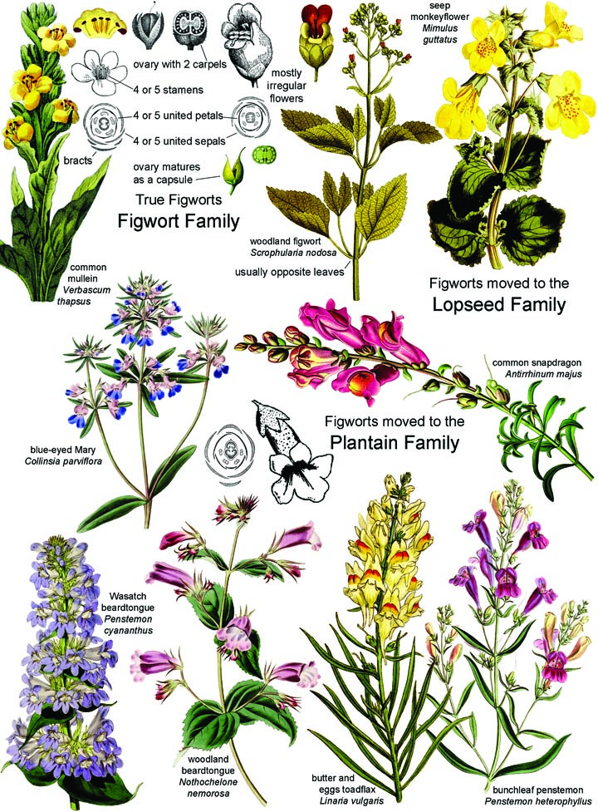
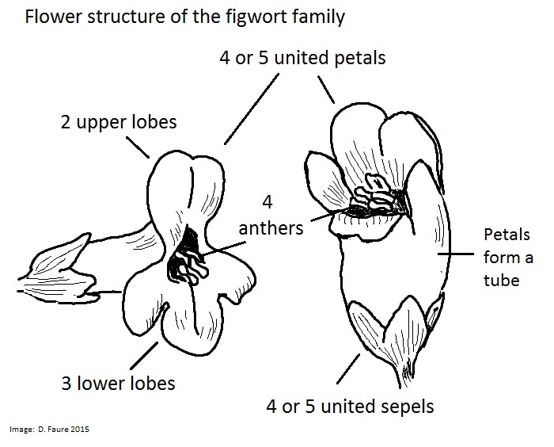
Application: Reclassification of the figwort family using evidence from cladistics.
Figworts were a large family (based on external characteristics)
DNA evidence suggests that many members of the family did not belong and they were reclassified.
Nature of science: Falsification of theories with one theory being superseded by another—plant families have been reclassified as a result of evidence from cladistics. (1.9)

Slide 10
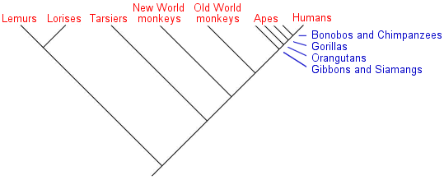
Application: Cladograms including humans and other primates.
Cladogram of primates based on homologous physical traits and genetic similarities

Slide 11
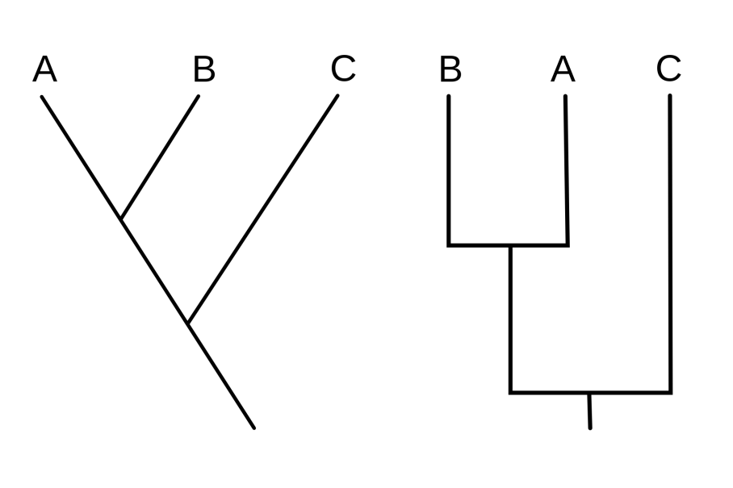
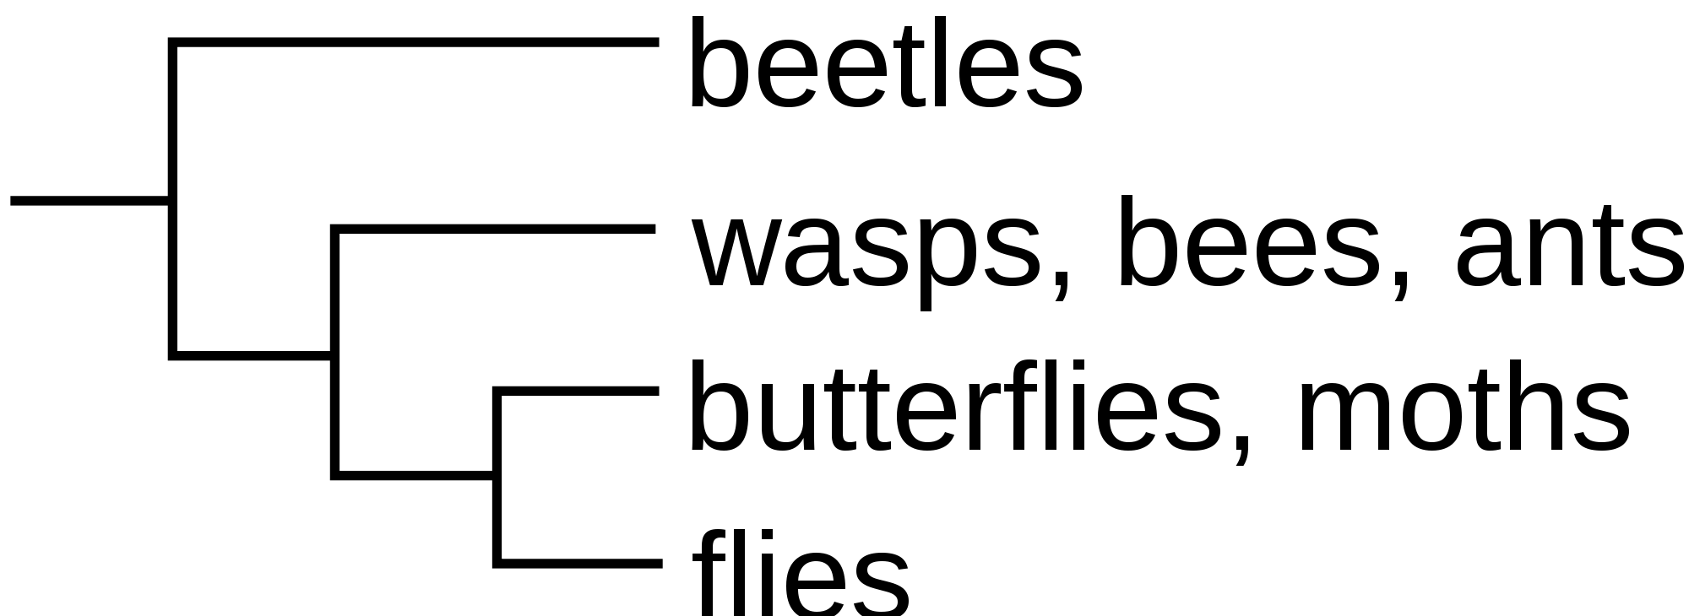
Skill: Analysis of cladograms to deduce evolutionary relationships.

Slide 12
TOK Discuss
A major step forward in the study of bacteria was the recognition in 1977 by Carl Woese that Archaea have a separate line of evolutionary descent from bacteria. Famous scientists, including Luria and Mayr, objected to his division of the prokaryotes. To what extent is conservatism in science desirable?

