Slide 1
Human Body Visual Study Guide
Biology

Slide 2
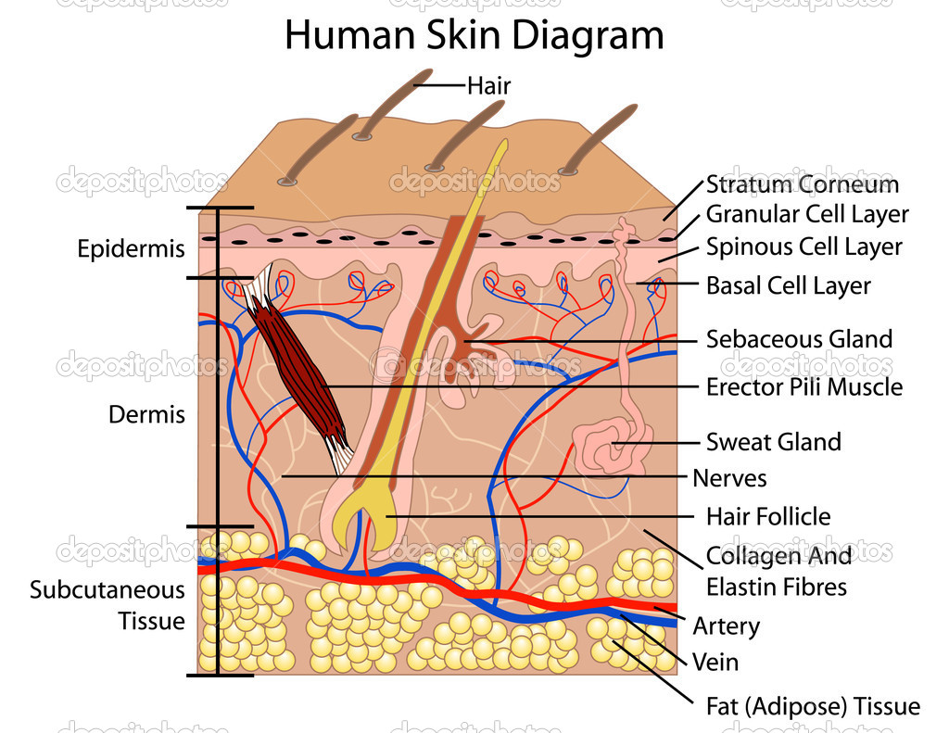
Skin (34.1) 1. What system does skin fall under?
Skin is part of the integumentary system – and also has a role in the immune and excretory systems.

Slide 3
Skin (34.1) 1. What is the role(s) of the skin?
Skin has many roles:
1st line of defense against pathogens
Regulate body temp
Protective coating
Insulation
Touch (along with nervous system)

Slide 4
Muscles (34.3) 1. What are the three types of muscles and list an example of each.

Slide 5
Muscles (34.3) 2. What are the names of two specific proteins involved with muscle contraction? Which one is thicker? Which one is thinner?
Actin (thinner) and Myosin (thicker)

Slide 6
Muscles (34.3) 3. What is the important element/mineral involved with muscle contraction? (hint: needed for strong bones)
Calcium!

Slide 7
Muscles (34.3) 4. Do we control voluntary muscle movement? Involuntary muscle movement?
Skeletal muscles are voluntary muscles under are control. Cardiac and Smooth are considered involuntary because they are not under our control.

Slide 8
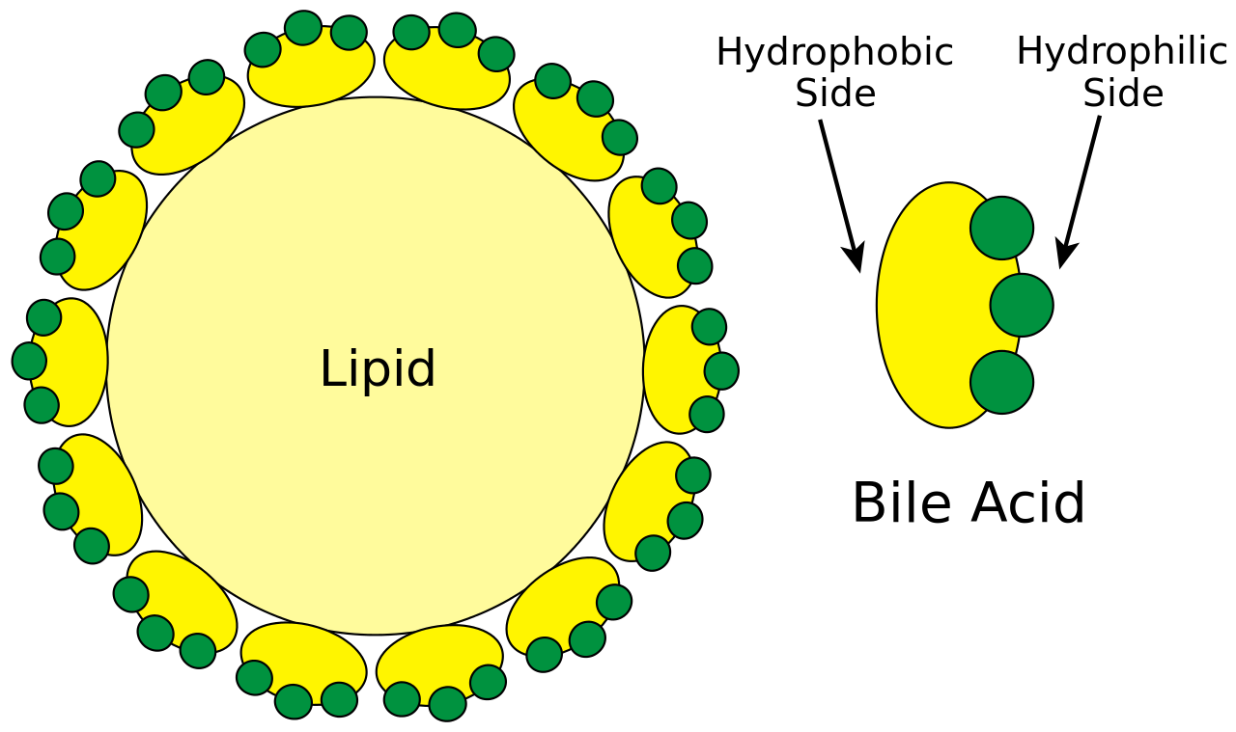
Digestive System (35.1-2) 1. What is bile? What is its function?
Bile is a digestive fluid that breaks down fat.

Slide 9
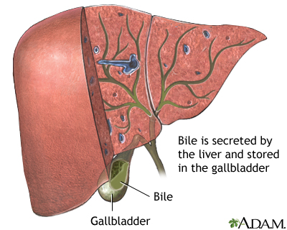
Digestive System (35.1-2) 2. Where is bile produced? Where is bile stored?
Bile is produced in the liver and stored in the gall bladder.

Slide 10
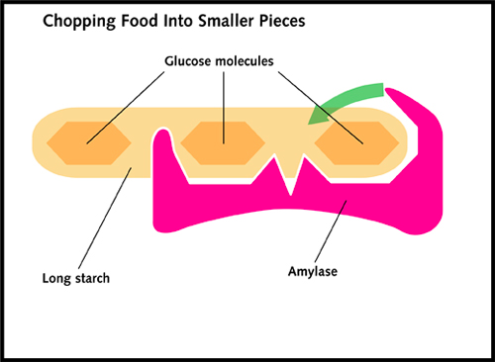
Digestive System (35.1-2) 3. What is the function of amylase and where is it found in the body?
Amylase is a digestive enzymes that breaks down starches. It is found in the mouth.

Slide 11
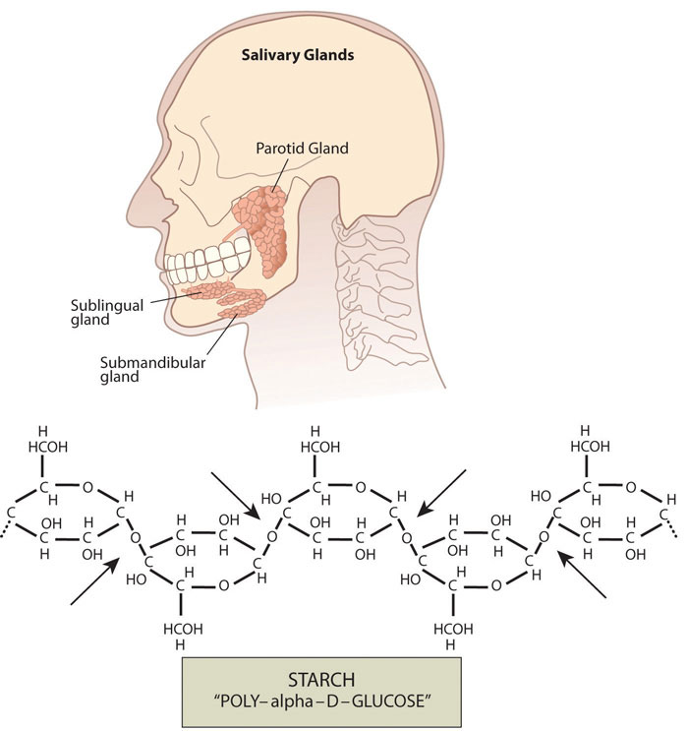
Digestive System (35.1-2) 4. Where does digestion first take place?
In the mouth! The teeth/tongue break up the food mechanically and digestive enzymes break up the food chemically.

Slide 12
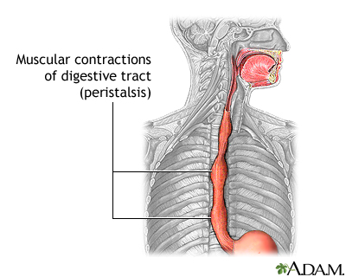
Digestive System (35.1-2) 5. What is the process in the esophagus that happens involuntarily called?
Food gets moved down the esophagus through peristalsis (smooth muscle contractions).

Slide 13
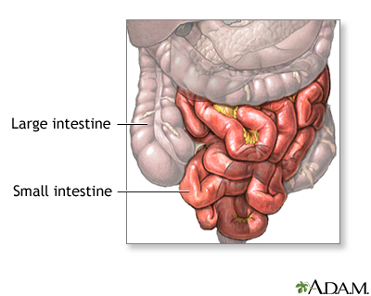
Digestive System (35.1-2) 6. Where does absorption take place?
Absorption of nutrients takes place in the small intestine. Absorption of water takes place in the large intestine.

Slide 14
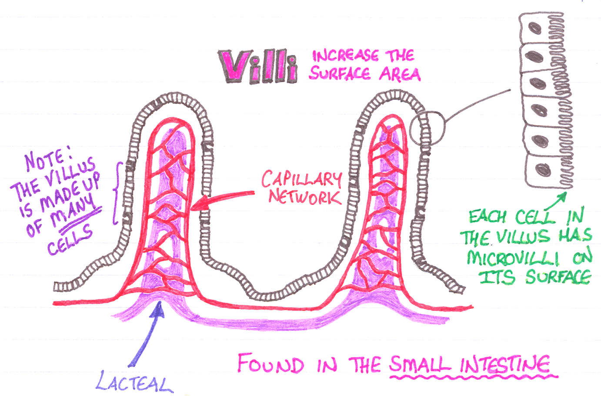
Digestive System (35.1-2) 7. What structure increases the surface area in the intestine?
Finger-like projections called villi increase the surface area in the intestine.

Slide 15
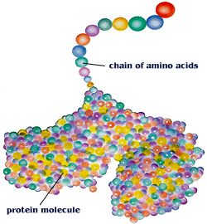
Digestive System (35.1-2) 8. What is the building block a protein?
Amino Acids!

Slide 16
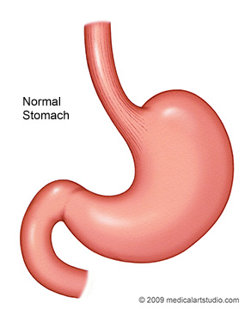
Digestive System (35.1-2) 9. What is the pouch-like muscle in your digestive system and what is its function?
The stomach – conducts both mechanical and chemical digestion (break-down) of food.

Slide 17
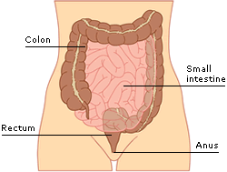
Digestive System (35.1-2) 10. What is the function of the rectum?
The rectum stores solid waste until it is ready to remove it from the body.

Slide 18
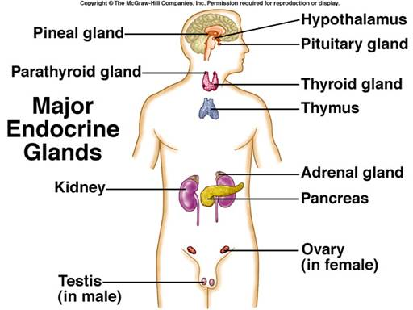
Endocrine (35.3) 1. What is the definition of an endocrine gland?
Endocrine glands secrete their products (hormones) directly into the blood.

Slide 19
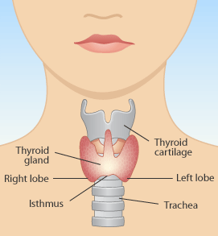
Endocrine (35.3) 2. What is the function of the thyroid gland?
The thyroid gland regulates the body’s metabolism.

Slide 20
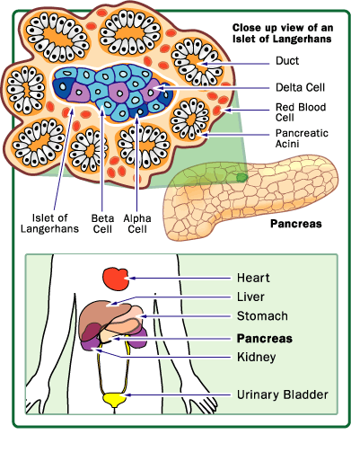
Endocrine (35.3) 3. What are the two hormones involved with regulating blood glucose?
Insulin and Glucagon are both involved with regulating blood glucose (sugar).

Slide 21
Endocrine (35.3) 4. Which hormone decreases blood glucose? Which increases blood glucose?
Insulin decreases blood glucose by encouraging the conversion of glucose to glycogen. Glucagon increases blood glucose by converting the glycogen back to glucose.

Slide 22
Endocrine (35.3) 5. What is negative feedback?
Negative feedback is a regulatory mechanism for reversing any changes in the body and restoring homeostasis.

Slide 23
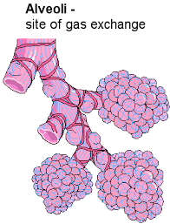
Respiratory – 37.1 1. Where does gas exchange happen in the lungs?
Gas exchange occurs in little sacs called the alveoli.

Slide 24
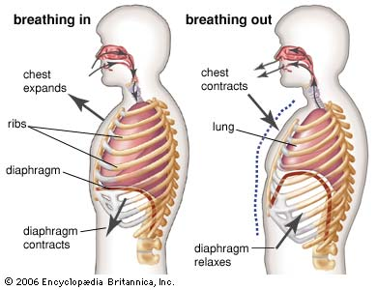
Respiratory – 37.1 2. When the diaphragm contracts (moves down) what happens? When the diaphgram relaxes (moves up) what happens?
When the diaphragm contracts, the volume increases and air rushes in. When the diaphragm relaxes, the volume decreases and air is pushed out.

Slide 25
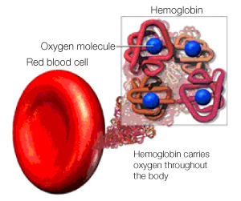
Respiratory – 37.1 3. What is the protein that is responsible for carrying oxygen in the blood?
Hemoglobin!

Slide 26
Respiratory – 37.1 4. What are the waste products of cellular respiration?
The waste products of cellular respiration are carbon dioxide and water.

Slide 27
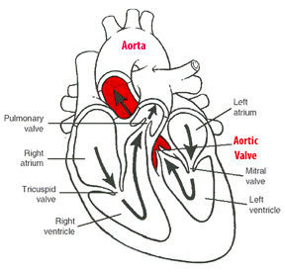
Circulatory – 37.2 1. What is the function of the aorta and where is it located on the heart?
The aorta is located at the top of the heart and the left ventricle pushes blood through it to most of the body.

Slide 28
Circulatory – 37.2 2. Does the pulmonary vein carry deoxygenated blood or oxygenated blood? Why is this different than most veins?
Most veins carry deoxygenated blood back to the heart. However, the pulmonary vein carries oxygenated blood from the lungs back to the heart.

Slide 29
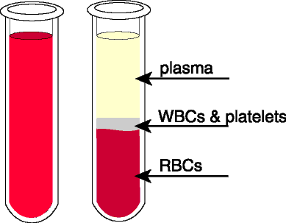
Circulatory – 37.2 3. What are the four components of blood and their functions?
Red Blood Cells – carry oxygen and some carbon dioxide.
White Blood Cells – fight off pathogens
Platelets – important for clotting
Plasma – fluid, maintains balance, transports nutrients, hormones, etc.

Slide 30
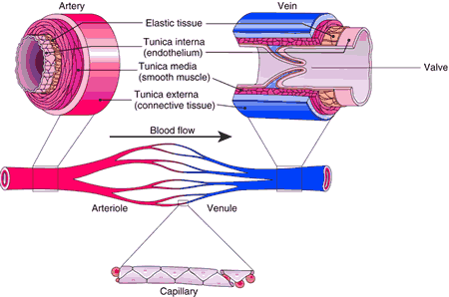
Circulatory – 37.2 4. Compare and contrast arteries and veins.
Arteries carry blood away from the heart. Veins carry blood towards the heart and have one-way valves so it doesn’t go backwards.

Slide 31
Circulatory – 37.2 5. What is hemoglobin? What is its function?
Hemoglobin is a protein in red blood cells that is responsible for carrying oxygen.

Slide 32
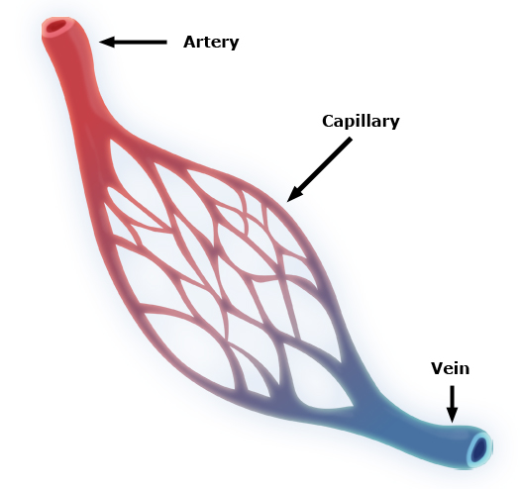
Circulatory – 37.2 6. What are capillaries and how big are they?
Capillaries connect arteries and veins and can be as small as one red blood cell wide.
They deliver oxygen and nutrients to cells and pick up waste products from cells.

Slide 33
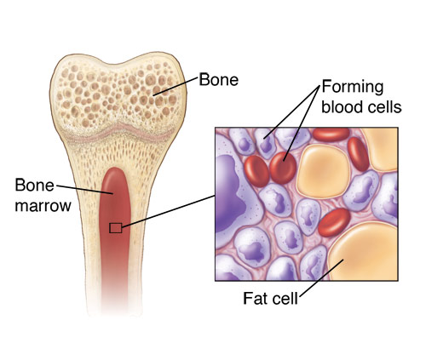
Circulatory – 37.2 7. Where are red blood cells made in the body?
Red blood cells are made in the bone marrow.

Slide 34
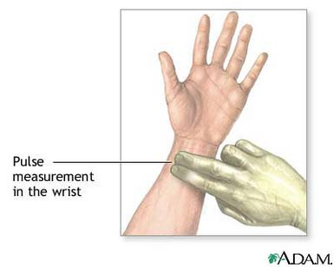
Circulatory – 37.2 8. What is the definition of a pulse?
A pulse is the rhythmic throbbing of arteries caused by contraction of the heart.

Slide 35
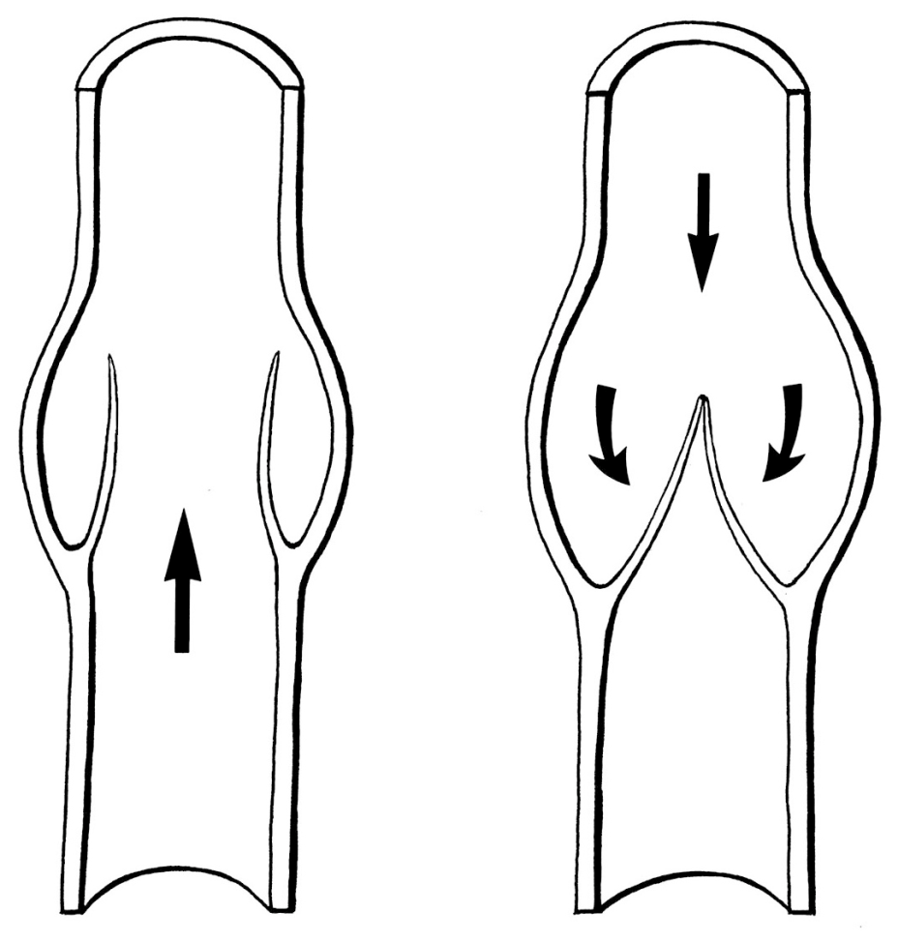
Circulatory – 37.2 9. What are valves?
Valves are one-way structures in veins and the heart that prevent backflow.

Slide 36
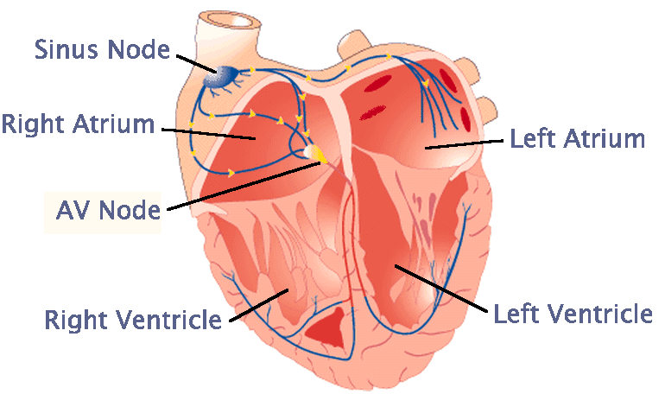
Circulatory – 37.2 10. What are the two upper chambers of the heart called?
The upper chambers of the heart are called the atria (sing: atrium).

Slide 37
Circulatory – 37.2 11. What are the two lower chambers of the heart called?
The lower chambers of the heart are called the ventricles.

Slide 38
Circulatory – 37.2 12. Draw a picture of the heart and lungs and label the parts.

Slide 39
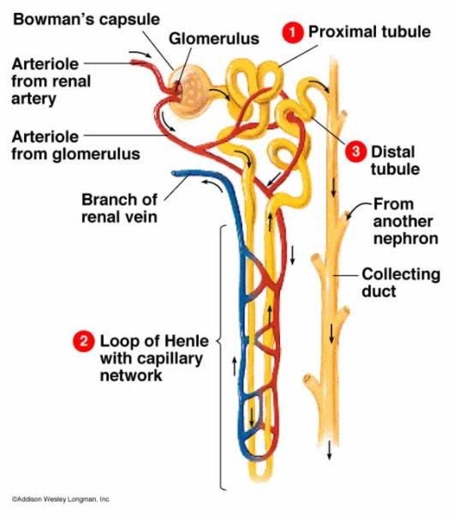
Excretory – 37.3 1. What is a nephron?
A nephron is the functional unit of the kidney, responsible for filtering the blood.

Slide 40
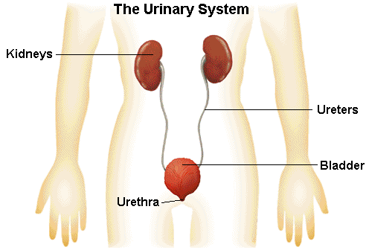
Excretory – 37.3 2. What are the three functions of the kidneys?
Filter blood
Removal of toxins
Regulation of water levels
Regulation of electrolyte/salt levels

Slide 41
Excretory – 37.3 3. What are the functions of the ureters and bladder?
The ureters transport the urine from the kidneys to the bladder.
The bladder stores the urine.

