Slide 1
Warm Up (top of 9R)
What is the difference between a monohybrid cross and a dihybrid cross?
What are you doing to study for next Tuesday’s benchmark? / what do you plan to do now that I’m reminding you to study?

Slide 2
Punnett Squares: Dihybrid Crosses
(9R)

Slide 3
Dihybrid crosses
Mendel wondered what kind of offspring pea plants that looked different from one another in TWO traits would have.
Would the 2 traits stay together in the next generation or would they be inherited independently of each other?
(well… this is where he made his conclusions about the law of independent assortment, so…)
Either way, there are way more possible offspring combinations with this type! SO BUCKLE YOUR SEATBELTS!

Slide 4
Example
A CcLl male is crossed with CcLl female … the possible offspring genotypes are :
CCLL, CCll, CCLl, CcLL, CcLl, Ccll, ccLL, ccLl, ccll
But how do we know that?
And what does all that mean?
Are there any patterns we see to make this a little easier?
WE NEED............

Slide 5
A Plan of ATTACK!!!!
FIRST: Create a system to sort all possible allele combinations from each parent!
THEN: drop / push to figure out all the possible genotypes for the offspring!

Slide 6
FOIL
We will use the FOIL method (YES! THAT FOIL METHOD FROM MATH!) to figure out the possible gametes for each parent (remember… the alleles segregate into each gamete during meiosis)

Slide 7
FOIL plan of attack
FIRST! Figure out the genotypes of both parents (old)
SECOND! Foil those genotypes to figure out possible gametes for each parent (new)
THIRD! Set up the Big Enchilada Punnett Square with 16 boxes (new)
LAST! Drop and push (old)

Slide 8
FOIL practice
In a breed of dogs, brown fur is dominant to yellow fur. In addition, they can have fluffy tails (dominant) or thin tails (recessive). If you cross a mom heterozygous for her brown fur and heterozygous for her fluffy tail with a dad homozygous brown fur with a thin tail, what would the offspring probably look like?

Slide 9
FOIL practice
In a breed of dogs, brown fur (B) is dominant to yellow fur (b). In addition, they can have fluffy (F) tails (dominant) or thin (f) tails (recessive). If you cross a mom heterozygous for her brown fur and heterozygous for her fluffy tail with a dad homozygous brown fur with a thin tail, what would the offspring probably look like?
1) Mom’s genotype: BbFf Dad’s genotype: BBff
2) FOIL to figure out gametes
3) make Big Enchilada punnett square; drop, push

Slide 10
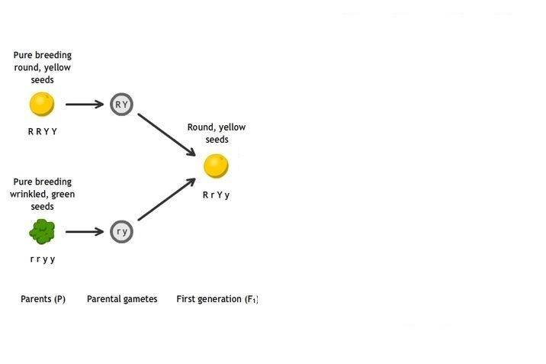
Let’s try one together
Round seeds (R) are dominant to wrinkled seeds (r)
Yellow seeds (Y) are dominant to green (y) seeds
A homozygous dominant pea plant (RRYY) is crossed with a homozygous recessive pea plant (rryy)

Slide 11
Thinking Cap
What is the difference you notice between the parents’ genotypes and the parents’ possible gametes?

Slide 12
F1 generation: will be 100% heterozygous
Let’s figure out the next generation, then (F2 generation):
A pea plant with ROUND (Rr) YELLOW (Yy) seeds is crossed with a pea plant with ROUND (Rr) YELLOW (Yy) seeds.
* Yellow = dominant
* Round = dominant
RrYy
x
RrYy
This is where things get weird!
. . .

Slide 13
Big Enchilada
Each F1 (1st generation after Parents) plant will produce gametes containing the following combinations of genes with equal frequency: round yellow (RY), round green (Ry), wrinkled yellow (rY), and wrinkled green (ry)
*WE FOUND BY FOIL’ing
 | RY | Ry | rY | ry
RY
Ry
rY
ry

Slide 14
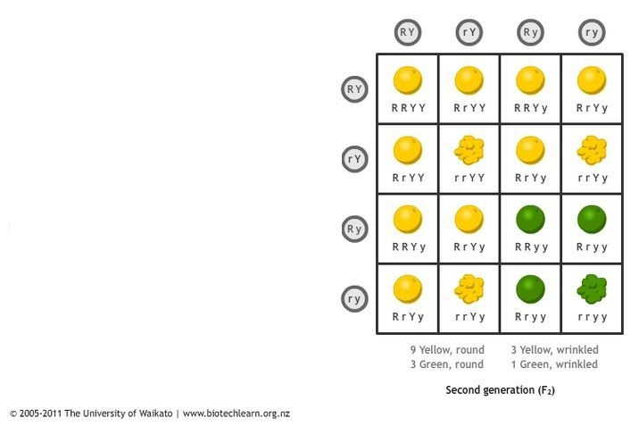
F2 generation
The F2 generation will show 4 different phenotypes
The phenotypic ratio is 9 : 3 : 3 : 1
9 round yellow seeds
3 round green seeds
3 wrinkled yellow seeds
1 wrinkled green seed

Slide 15
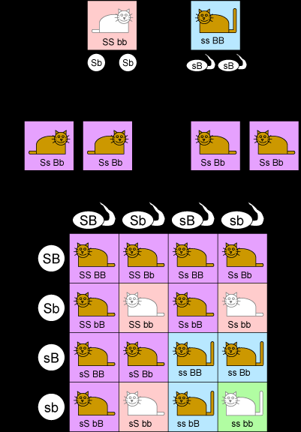
Meow!
WHAT ARE THE MAJOR STEPS WE MUST DO?
P generation:
FOIL (gametes):
F1 generation:
F2 generation:
Analysis:

Slide 16
Practice at Home!!
http://www.athro.com/evo/gen/punexam.html
http://scienceprimer.com/punnett-square-calculator

