Slide 1
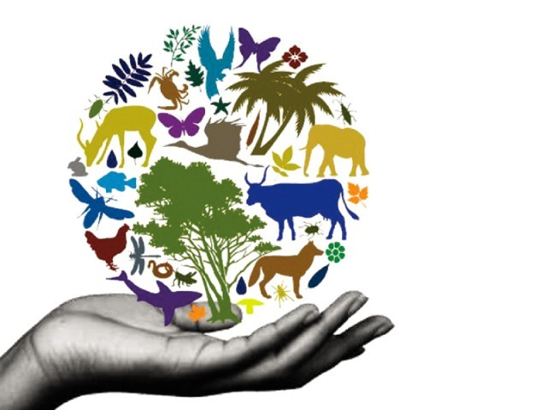
Ch. 5 Biodiversity & Conservation (10R)
(8R)

Slide 2
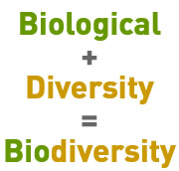
IMPORTANT:
BIODIVERSITY refers to the sum total of different kinds of organisms in an area.
Basically the # of different populations!
NOT just the # of organisms
It is affected by changes in the habitat!
* bio =
* diversity =

Slide 3
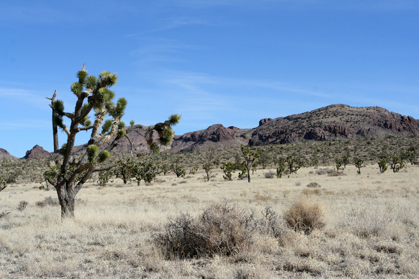
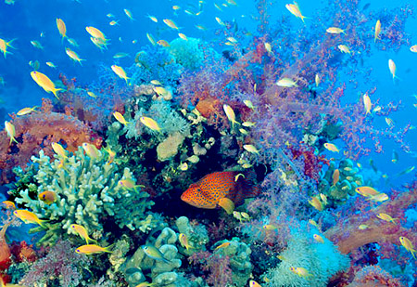
Thinking Cap!
Compare and contrast the biodiversity seen in these 2 pictures (coral reef vs. desert)

Slide 4
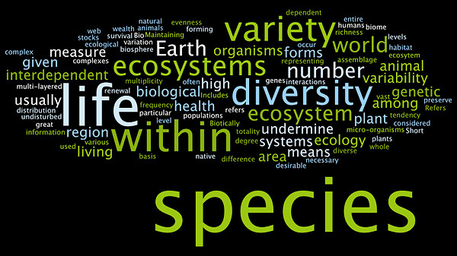
Thinking Cap
Try to put the definition for biodiversity in your own words. Use this Wordle to inspire you! (Hint: the bigger the word, the more important it is to the concept of biodiversity)

Slide 5
Thinking Cap
Area | Species U | Species V | Species W | Species X | Species Y | Species Z
A | 3 | 7 | 2 | 2 | 2 | 4
B | 0 | 6 | 8 | 0 | 6 | 6
C | 0 | 0 | 2 | 0 | 0 | 2
D | 4 | 3 | 11 | 1 | 6 | 0
Partner A: Which area has the greatest biodiversity? How do you know?
Partner B:Which area has the greatest abundance? How do you know?
Both: Which area is most likely to be a desert? How do you know?

Slide 6
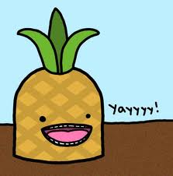
Threats to Biodiversity
Now you that you know more about populations and diversity … you can “analyze changes in ECOSYSTEMS”

Slide 7
FYI:
Analysis means you examine and break information down into parts by identifying causes.
[This] caused [this] to change in the ecosystem.
Analysis also means you make inferences and find evidence to support generalizations.
I infer that [this] leads to [this] in the ecosystem based on [this evidence].

Slide 8
Changes in population size
Overcrowding
( in pop. size):
Leads to diseases
Increases Competition for Limited Resources
More deaths
Less Births
→ Lower biodiversity

Slide 9
Review
What are the factors whose effects increase as the population increases?

Slide 10
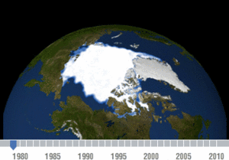
Climate Change
Climate is long-term weather in a particular place
If it changes, all the adaptations organisms have made to live successfully in that climate are no longer necessary.
Most organisms cannot survive changes to their climate!
→ Lower biodiversity

Slide 11
Thinking Cap
Think of an animal that is perfectly adapted to the environment it lives in… What would happen if the temperature there increased (or decreased) 50 degrees F? (ie: Scar – Tundra)

Slide 12
Human Activity
We are terrible (!) at sharing this planet:
Clearing habitats for homes, shopping centers, cities, or farming
Using resources for human needs (wood for structures, etc.)
Our lifestyle releases pollutants into the environment (CO2 → greenhouse gas → climate change)
→ Lower biodiversity

Slide 13
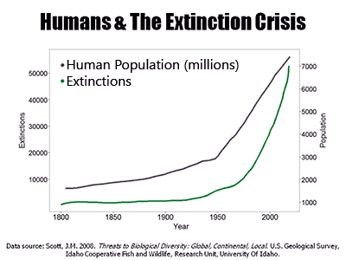
Thinking Cap
Evaluate:
“human population increase has definitely caused extinctions to increase.”
Partner A – pro
Partner B - con

Slide 14
Introduction of non-native species
NATIVE species
Organism adapted to a particular habitat
When NON-NATIVE (or “exotic” or “invasive”) species are introduced to that environment, the native populations are usually out-competed or eaten by the invaders!
WHY? These turds have no natural predators in their new environment and tend to thrive there!
AHHH!!!

Slide 15
Thinking Cap
In this environment, are humans native or non-native species?
Justify your answer (using evidence from all that we just learned)

Slide 16
How are we feeling??

Slide 17
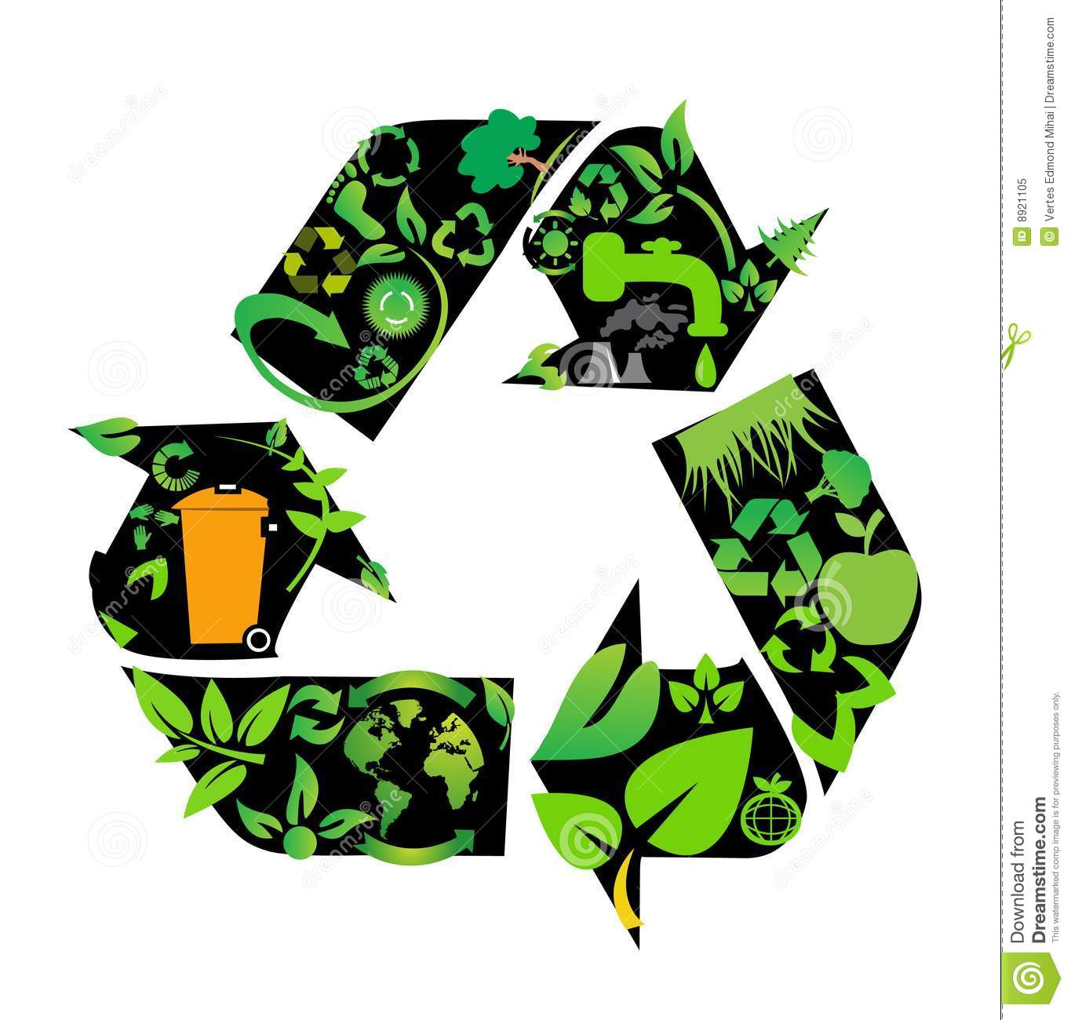
Conservation
Basically: Methods that protect biodiversity
Include both preservation of species AND habitat

Slide 18
Preservation
Habitats must be preserved (protected) in order to save species!
National parks & preserves
Yellowstone
Santa Rosa Plateau*

Slide 19
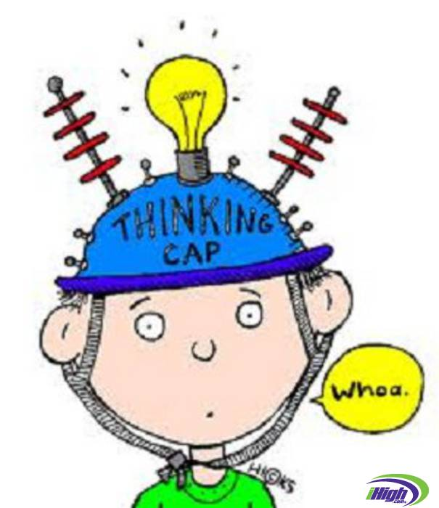
Thinking Cap
What is the relationship between “conservation” and “preservation?”

Slide 20
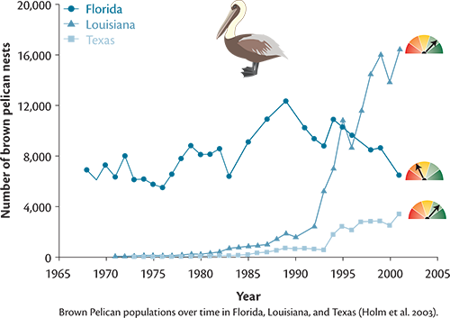
Reintroduction
Captive-breeding programs take animals that have VERY low #s in the wild and attempt to increase those #s
When enough have been born/ raised, they can be reintroduced to their natural habitat

Slide 21
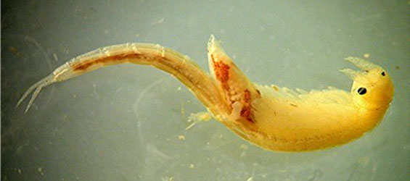
Endangered species
The Endangered Species Act of 1973 made it illegal to harm any species on the endangered or threatened species list.
Harm includes changing an ecosystem where these species live
Ex: Santa Rosa Plateau Ecological Reserve
Endangered: Fairy Shrimp

Slide 22
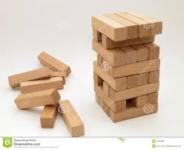
Thinking Cap
WHY SHOULD WE CARE ABOUT A SILLY LITTLE FAIRY SHRIMP!?!?!

Slide 23
Extinction
= The end of the line for most species
No more breeding pairs to continue the species
99.9% of species that have ever existed have gone extinct, so it is a natural process
HOWEVER(!), we are definitely helping it along :/
Relationship of Land Area to Extinctions
Island | Area in km² | Initial # of species | Extinctions | Percent of Loss
Borneo | 751,709 | 153 | 30 | 20
Java | 126, 086 | 113 | 39 | 35
Bali | 5,443 | 66 | 47 | 71
Show video clip!

Slide 24
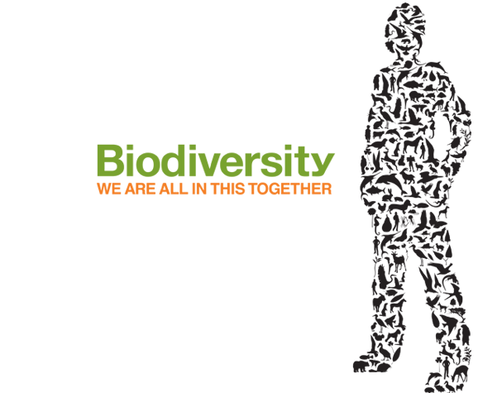
On 10L of your notebook
Why is biodiversity important?
2. What is more effective, species protection or habitat protection? Why? Explain…
3. What is the relationship between “biodiversity” and “conservation?”

Slide 25
10L

Slide 26
On 10L: Ecology Reflection (4-6 sentence paragraph, please!)
On a scale of 1-10 (1= bad; 10 = a!m!a!zing), how are you feeling about Ecology content?
What are you doing to prepare for next week’s benchmarks? If nothing (yet), what could you be doing to prepare?
Where can you find more resources to help you get ready for next week’s benchmarks?
What was your favorite concept from this unit?
What was your favorite activity from this unit?

