Slide 1
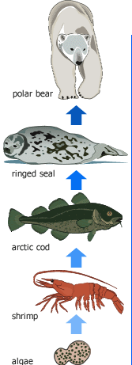
Warm Up (discuss only)
In this food chain, which population will have the LEAST number of organisms?
& WHY?
2. How do populations of ants differ from populations of humans?
3. During which 5-year period did the turtle population decrease the most?
Year | Turtle Population
1985 | 132,000
1990 | 130,000
1995 | 124,000
2000 | 116,000
2005 | 100,000
2010 | 93,000
2015 | 89,000
shrimp
algae

Slide 2
Ch. 3.1: Communities Ch. 4: Population Dynamics
(7R)

Slide 3
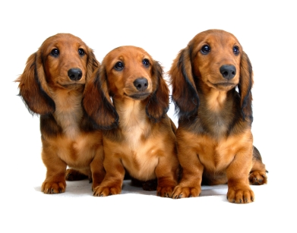
IMPORTANT:
Remember:
A POPULATION is a group of individuals of the same species in the same area.

Slide 4
How fast do they grow?
Well… it depends!
Linear growth? (straight 1:1 relationship)
Over time, the population increases at a steady rate
NOPE! (but WHY?!)
Exponential growth? (J-shaped growth curve)
Slow to begin, but more reproduction means there are more being born and therefore even more reproducing, etc.
Maybe… it depends on the environment

Slide 5
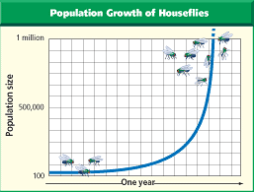
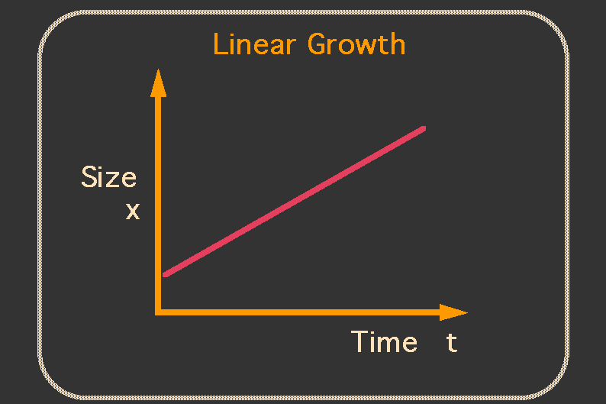
Which is which? How do you know?

Slide 6
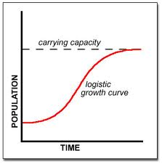
S-shaped growth curve
Logistic Growth? YESSSSS!
The population growth increases slowly at first, then explodes(!), then finally hits the carrying capacity* of the environment and levels off

Slide 7
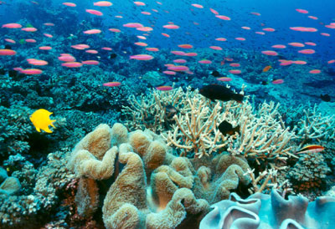
Carrying Capacity*
The number of organisms of a particular species that an environment can support.

Slide 8
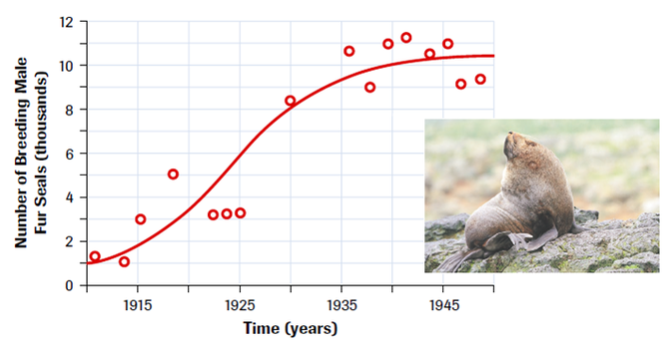
Thinking Cap
What contributes to the ‘leveling off’ of the population?
What else might affect population growth?

Slide 9
Limiting Factors
Factors that affect an organism’s ability to survive in its environment
Biotic OR Abiotic factors that restrict the existence, numbers, reproduction, or distribution of organisms.
Examples: water, food, predators, and temperature.
CAN BE EITHER DENSITY-DEPENDENT or DENSITY-INDEPENDENT! . . . . . . . .

Slide 10
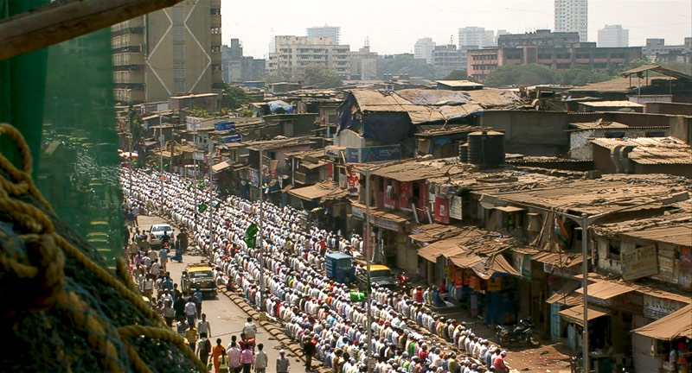
Density-Dependent Factors
= Limiting Factors that have an increasing effect as the population increases
Examples: disease, competition, predators, parasites, and food availability

Slide 11
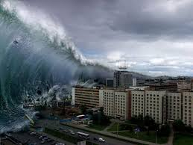
Density-Independent Factors
= Limiting factors that affect populations regardless of their size
Examples: usually abiotic factors (natural disasters, habitat disruption)

Slide 12
Thinking Cap
What is the relationship between “Limiting Factors” and “Carrying Capacity?”
Answer: “I think the relationship between limiting factors and carrying capacity has to do with . . . “
(hint: think about a specific type of ecosystem... That usually helps ☺)

Slide 13
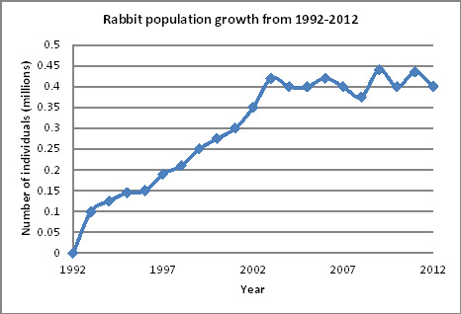
Thinking Cap
What might have happened here?
(hint: read the title & axes for more info)

Slide 14
Quantitative Data
Birth: a new organism of that species is introduced to the world.
Death: an organism of that species is no longer part of the world.
Immigration: organisms of that species move Into & settle a place where they are not native.
Emigration: organisms of that species Exit & settle a place where they are not native.

Slide 15
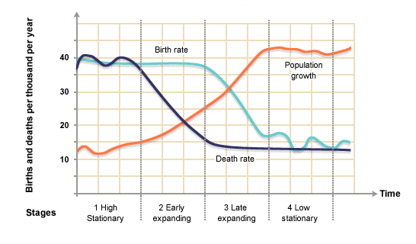
Population changes
The rates of birth, death, immigration, and emigration change the overall population #s.

Slide 16
Thinking Cap!
When the birth rate is HIGHER than the death rate, what happens to the overall population #?
When the emigration rate is HIGHER than the immigration rate, what happens to the overall population #?

Slide 17
Population Growth Rate (PGR)
PGR = (birth rate + immigration rate) – (death rate + emigration rate)
PGR > 0 = increasing population
PGR < 0 = decreasing population

Slide 18
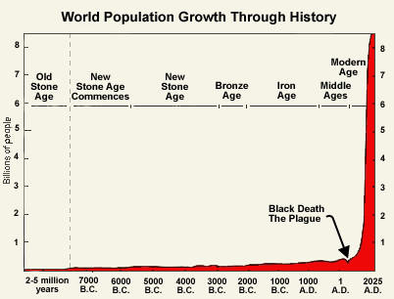
On L of your notebook
REFLECT (4+ sentences) on the human population growth trends you see in this graph …
What does it mean to you?
Do you find this scary? Why / why not?
What type of growth does this appear to be so far? Explain…
Does this change your mind about how many kids you want to have? (China 1 kid policy)
When do YOU think we will reach our carrying capacity? Why?

