Slide 1
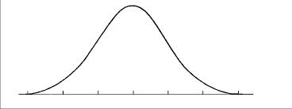
Warm Up (discussion only)
Think of the camouflage lab:
What happened to the red beads?
If the red beads were actually prey species, what might happen to them, in the long run?
If the black and clear beads were considered “extreme” variations of the same species, what might happen to the population of that species over enough time? (hint: type of selection)

Slide 2
Speciation: Survival of the fittest…or else
Mrs. A
(6R)

Slide 3
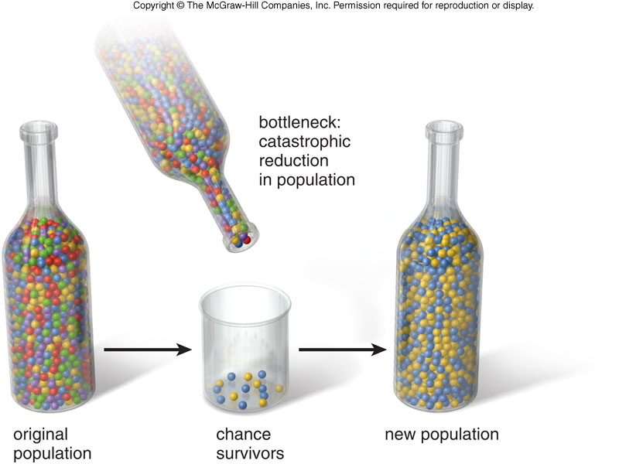
Updated Definition of Evolution
A change in the allele frequencies of certain heritable characteristics over many generations
This is called the Bottleneck Effect for how it affects a population!
- Small populations are more affected by this! (ex: Amish – Founder Effect)

Slide 4
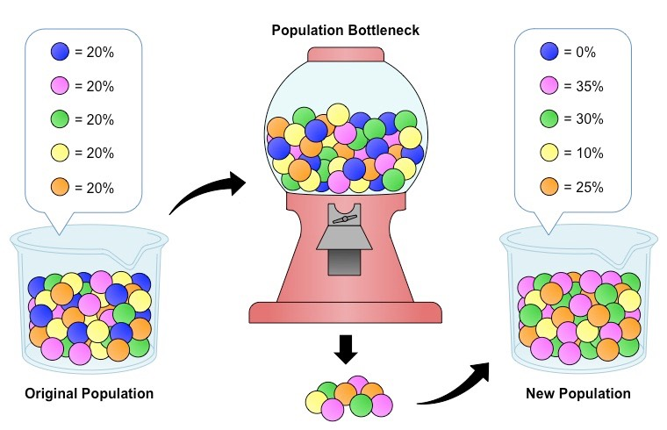
Thinking Cap
How does the bottleneck affect show Evolution?
(<hint hint> use the new definition)

Slide 5
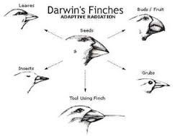
Darwin: The Controversy
Darwin Observed that characteristics of many plants and animals vary greatly among the Galapagos islands
Darwin’s Hypothesis: Separate species may have arisen from an original [common] ancestor

Slide 6
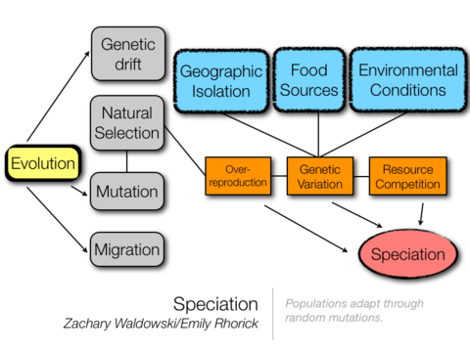
Speciation
Old: SPECIES = individuals who can breed and make viable babies
New: SPECIATION = the splitting of 1 population into 2 different ones
Can happen as a result of mutations, genetic drift, gene flow, or ISOLATION…
Talked about already
New today

Slide 7
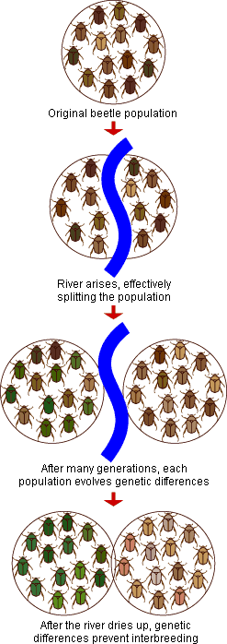
Geographic Isolation
The geography splits up the population, leading to 2 independent (non-breeding) populations over time
Geography = canyon, lake, mountain, river, etc.

Slide 8
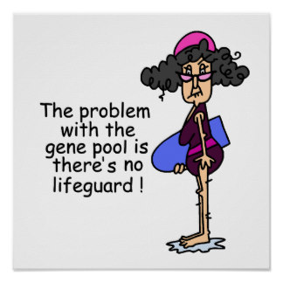
Thinking Cap
Do populations that are geographically isolated from one another share a gene pool?
Explain…

Slide 9
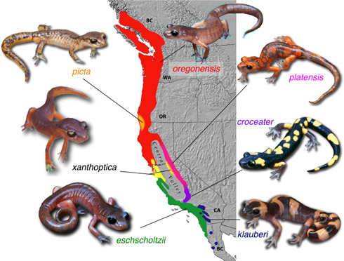
Let’s watch a video!
https://www.youtube.com/watch?v=aDIQFQOCGaI

Slide 10
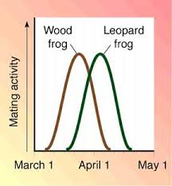
Temporal Isolation
Differences in timing split up the population, leading to 2 independent (non-breeding) populations over time
Time = mating season, hibernation, etc.

Slide 11
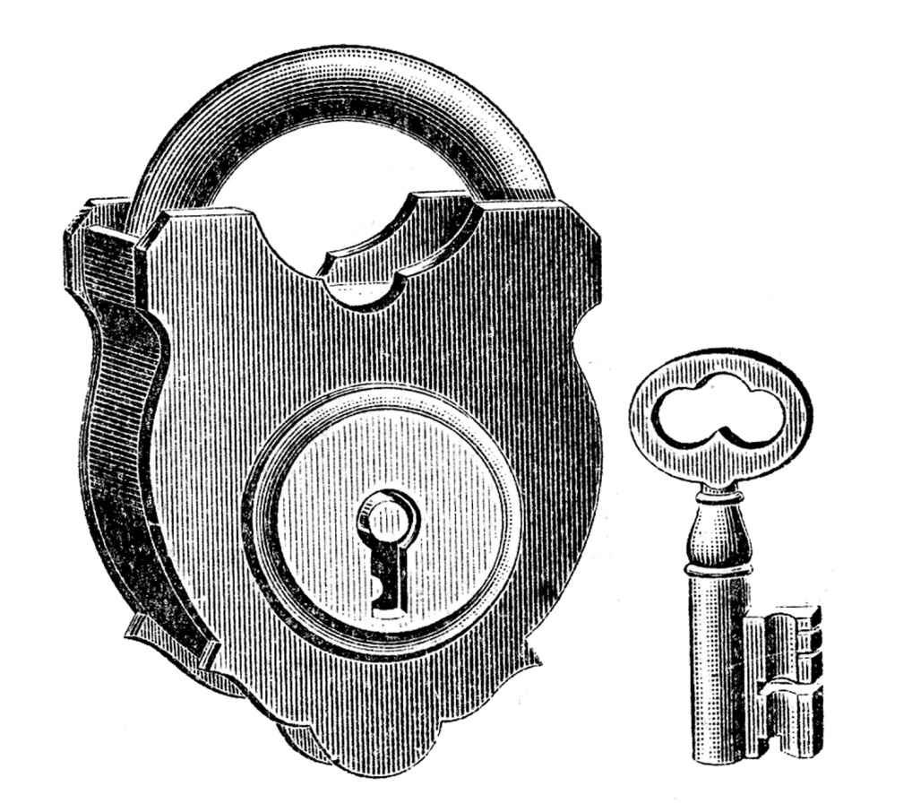
Mechanical Isolation
The reproductive parts don’t fit, which means the genetic info won’t be swapped, leading to independent populations over time

Slide 12
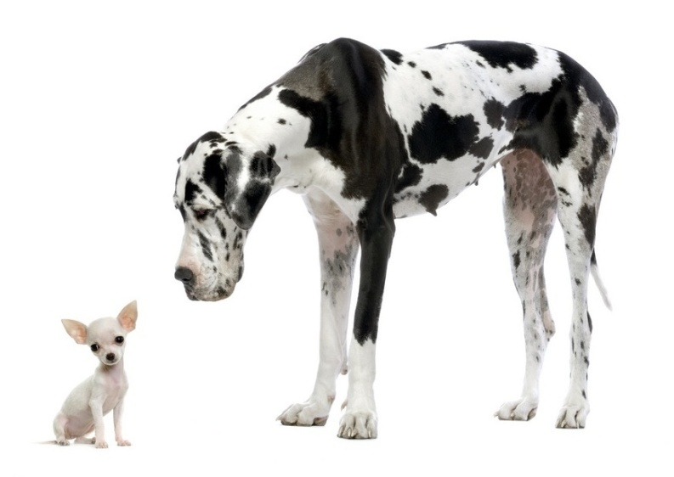
Thinking Cap
Sometimes mechanical & temporal isolations are considered types of REPRODUCTIVE ISOLATION.
– Why? Give an example to support

Slide 13
You got this?!
Identify which type of isolation is being show in each example below: G = geographic T = temporal M = mechanical
_______2. Two species of plants sprout at different months in the year.
_______3. Two species of squirrels get stranded on either side of a grand canyon.
_______4. Two species of mountain lions live in a forest on either side of a large river.
_______5. A male great dane and a female chihuahua try to make babies :/
_______6. Two species of foxes mate in different seasons.

Slide 14
Cospeciation
If the association between two species is very close, they may speciate in parallel.
It is especially likely to happen between parasites and their hosts.
Ex: Gophers + lice

Slide 15
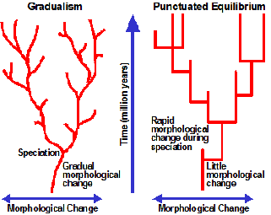
Rates of Speciation
Speciation happens at different rates
Gradualism = species originate through a gradual change of adaptations
Some fossil evidence to support this
Punctuated Equilibrium = speciation occurs relatively quickly, in rapid bursts, with long periods of genetic equilibrium in between
More fossil evidence seems to support this

Slide 16
Let’s hear a song!
http://www.youtube.com/watch?v=WDPsZPKSEFg

Slide 17
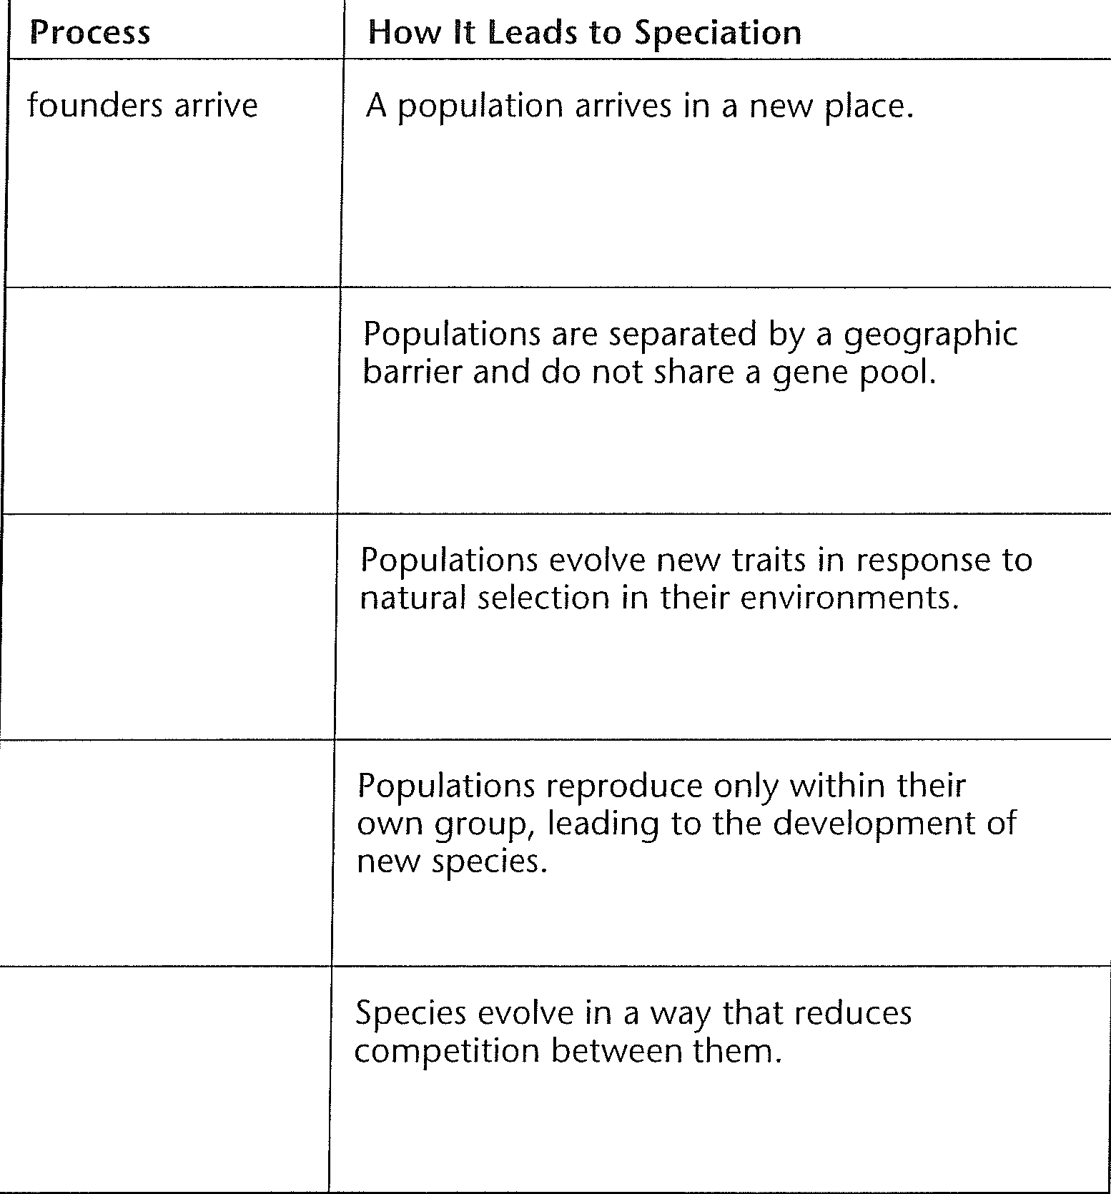
On 6L of your notebook
Word bank:

Slide 18
Five in Five
In 5 words or less define each of the following:
1. Gene Pool
2. Gene Flow
3. Phenotype
4. Genetic Drift
5. Speciation

