Slide 1
That’s some Reflex you got there!
(3R)

Slide 2
Thinking Cap?
Why might we need reflexes?
Give several specific examples…

Slide 3
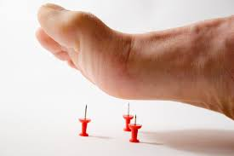
Reason for Reflexes
To prevent damage to the body
Reflexes are responses that don’t involve the input from your brain
Because they “bypass” the brain, they happen very quickly, without you having to think about doing anything!

Slide 4
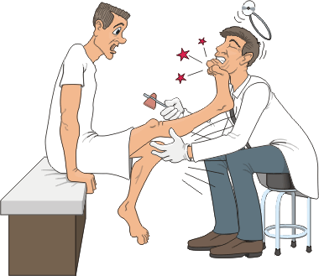
Thinking Cap
Do you think we have reflexes when we’re born, we develop them, or some combo? Explain
Mrs. A will show a video clip...
(https://www.youtube.com/watch?v=_JVINnp7NZ0)

Slide 5
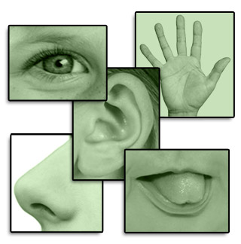
Reflex Arc (step 1)
if you touch something hot:
1. the heat (stimulus) will trigger the sensory receptors in your finger, which will send the message on via sensory neurons
Why do you think they are called sensory neurons?

Slide 6
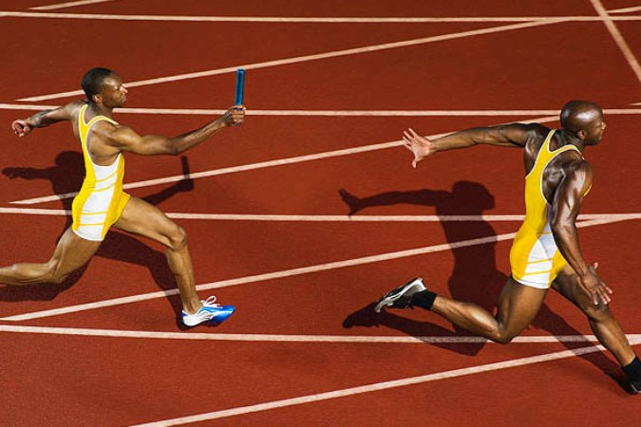
Reflex Arc (step 2)
2. This impulse which will travel to your spinal cord.
Acts like a “relay point” between sensation & response
The impulse travels through an interneuron in the spinal cord and then passes back out to a…

Slide 7
Reflex Arc (step 3)
3. Motor neuron!
The motor neuron carries the impulse to the muscle (effector), which contracts quickly in response, thereby moving your finger out of danger.
End of reflex arc! You saved the princess!

Slide 8
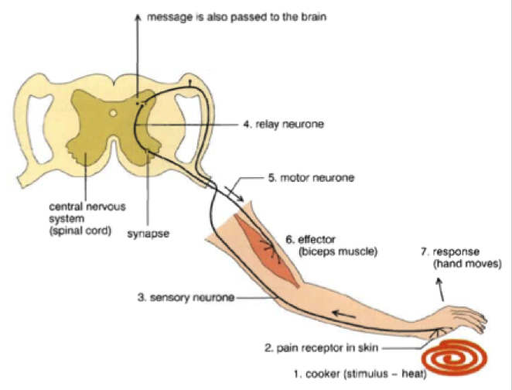
Reflex Arc!
4. interneuron

Slide 9
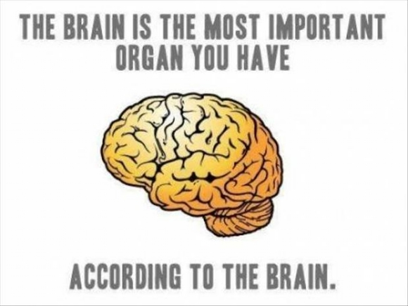
Brain finally gets on board…
The message travels to your brain where it gets interpreted.
You’ve already moved your hand out of the way before your brain has even registered that you’ve touched something hot / sharp!

Slide 10
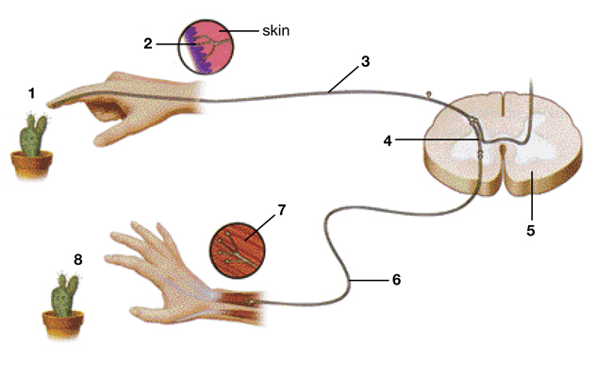
Draw & label the Reflex Arc (still on 3R)
Word Bank:
Effector
Interneuron
Sensory receptor
Stimulus
Motor neuron
Spinal Cord
Sensory Neuron
Response
Now let’s throw stuff at each other! …

