Slide 1
True / False?
T / F – Blue eyes are recessive
T / F - Twins can be born with vastly different color skin
T / F – There are 8 different blood types (* not counting Rh+ and Rh- )
T / F – Blood type O is considered the “universal recipient”

Slide 2
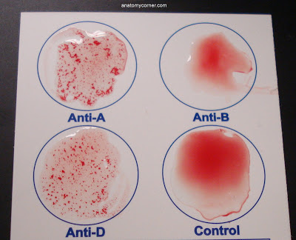
Polygenic Traits: especially Blood Typing (6R)

Slide 3
First, some vocab:
Sometimes there are more than two alleles that govern the phenotype of a trait
Polygenic Traits: the presence of more than two alleles for a genetic trait
Ex: hair color, eye color, skin color, blood type
NOTE: we’re still just looking at 1 trait, though, so we still do a monohybrid cross (regular Punnett )
Thinking Cap: can there ever be a genotype with an odd # of alleles? Ex: AaBbC

Slide 4
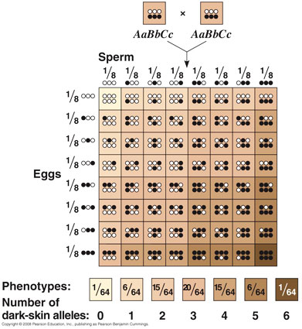
Examples include

Slide 5
Another important Polygenic trait: Blood Type
Human blood type is governed by the presence of 3 different alleles:
A
B
O
However, each person only has 2 of these 3 alleles in their genetic code

Slide 6
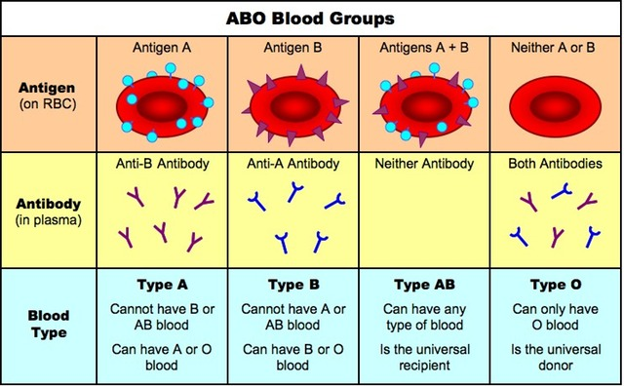
What does that actually mean?
The blood type is determined by the presence or absence of certain molecules on the surface of red blood cells.

Slide 7
Which blood type are you if you have…
AA
Type A blood
BB
Type B blood
AB
Type AB blood
AO
Type A blood
BO
Type B blood
OO
Type O blood

Slide 8
Thinking Cap
Which blood type is most common?
Why?
Phenotype | Genotype
A | AA or AO
B | BB or BO
AB | AB
O | OO

Slide 9
Blood Types & the Population
 | Caucasians | African Americans | Hispanics | Asians
O + | 37% | 47% | 53% | 39%
O - | 8% | 4% | 4% | 1%
A + | 33% | 24% | 29% | 27%
A - | 7% | 2% | 2% | 0.5%
B + | 9% | 18% | 9% | 25%
B - | 2% | 1% | 1% | 0.4%
AB + | 3% | 4% | 2% | 7%
AB - | 1% | 0.3% | 0.2% | 0.1%
THINKING CAP: Why do you think?!?! (don’t worry about the + / - for now!)

Slide 10
Blood Type – pattern(s) of inheritance
Blood types follow both Codominant and simple Dominant inheritance
The A allele and B allele are codominant with each other
The A allele and B allele are both purely dominant over the O allele
The O allele is recessive

Slide 11
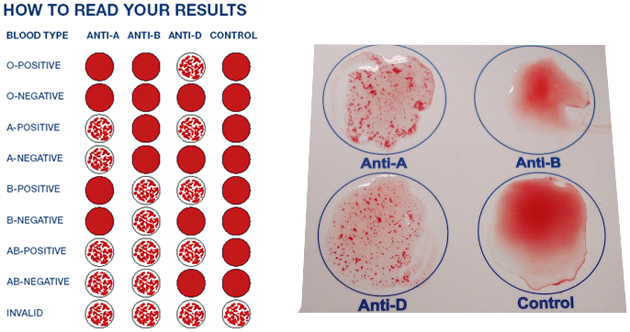
By the way...
Less than $10 for a kit
Order online!
What would this person’s blood type be?
https://www.youtube.com/watch?v=H0y9An0DOq8

Slide 12
Let’s do some Punnett Squares!!!
The blood type gene and alleles are actually represented differently than you have seen before…
The allele for the blood type gene is I
For this gene you can have the following alleles:
For A: I^{A}
For B: I^{B}
For O: i

Slide 13
Let’s stop and think…
What are the two allele combinations you can have for type A blood?
I^{A}I^{A} (homozygous) and I^{A}i (heterozygous)
What are the two allele combinations you can have for type B blood?
I^{B}I^{B} (homozygous) and I^{B}i (heterozygous)

Slide 14
Let’s Stop and Think…
What is the only allele combination you can have for type AB blood?
I^{A}I^{B}
What is the only allele combination you can have for type O blood?
ii

Slide 15
Sample Punnett Squares
What blood type(s) will the children of two type AB parents have? Any O babies?
We need to do a Punnett Square!!!
First – what are the genotypes of the parents?
^{Mom’s genotype:} __?__
^{Dad’s genotype:} __?__
 | I^{A} | I^{B}
I^{A} | I^{A}I^{A} | I^{A}I^{B}
I^{B} | I^{A}I^{B} | I^{B}I^{B}

Slide 16
Sample Punnett Squares
What blood type(s) will the children of two Type O parents have?
 | i | i
i | ii | ii
i | ii | ii
******Genotypic frequencies? Phenotypic frequencies?******

Slide 17
Sample Punnett Squares
Is it possible for a Type A person and a Type B person to have babies with non-A and/or non-B blood?
PROVE IT!
 | I^{A} | i
I^{B} | I^{A}I^{B} | I^{B}i
i | I^{A}i | ii
******Genotypic frequencies? Phenotypic frequencies?******

Slide 18
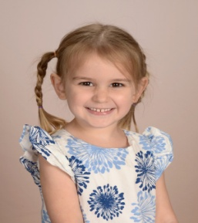
Sample Punnett Squares
What blood type(s) will the children of a Type A dad and a Type O mom have?
[WHAT DO WE NEED TO KNOW ABOUT HIM 1st?]
 | I^{A} | i
i | I^{A}i | ii
i | I^{A}i | ii
My husband’s blood type
My blood type

Slide 19
An “easy” way to think about it…
Parent 1 |  | AB | AB | AB | AB | B | A | A | O | O | O
Parent 2 |  | AB | B | A | O | B | B | A | B | A | O
Possible blood type of child
 | O |  |  |  |  |  | X | X | X | X | X | X
 | A |  | X | X | X | X |  | X | X |  | X
 | B |  | X | X | X | X | X | X |  | X
 | AB |  | X | X | X |  |  | X

