Slide 1
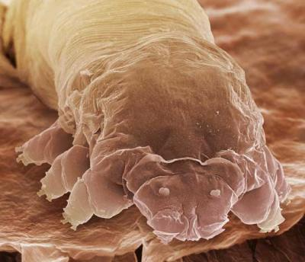
Ch.7.1: Intro to Microscopes!
(7R)
Oh hai!

Slide 2
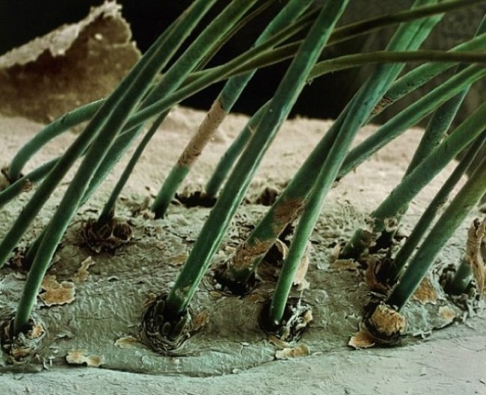
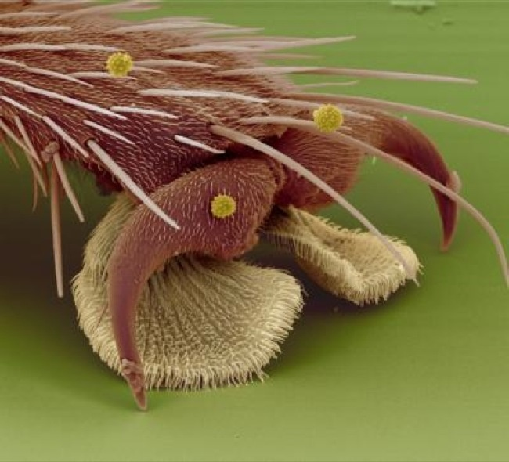
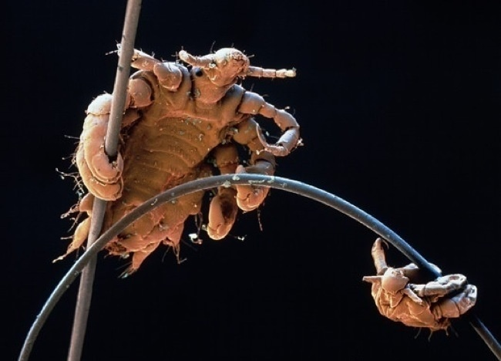
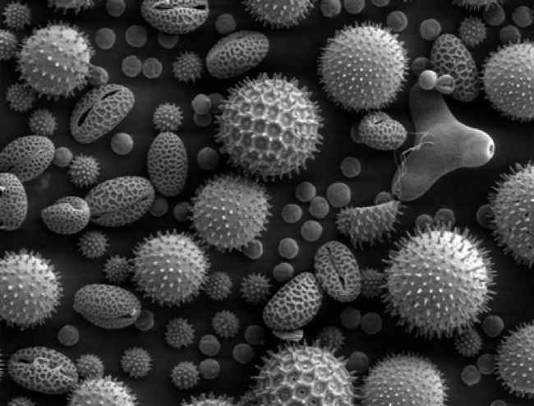
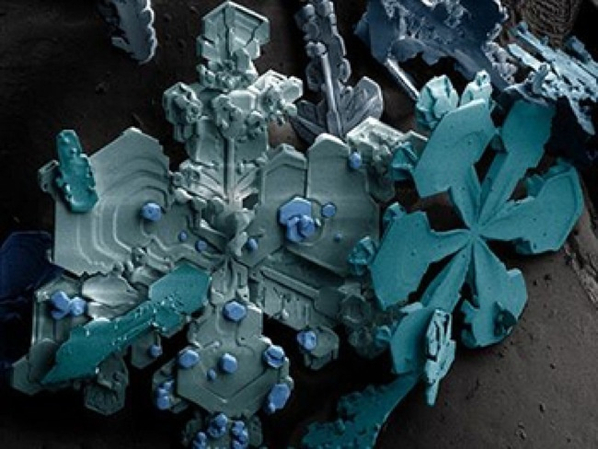
Notes:
Top left = eyelashes (SEM), bottom left = pollen (SEM), middle = human head louse (SEM), top right = fly leg (SEM), bottom right = snowflake

Slide 3
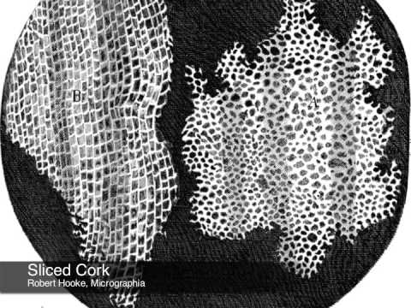
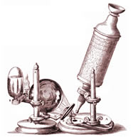
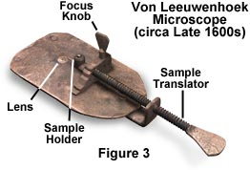
History of Microscopes
Micro = ?
the 1st microscopes were very basic
Stage + lens
Crude light source

Slide 4
A few notable names
Don’t write this down!!
(1574) Janssen brothers – eyeglass makers curious about magnification
Developed one of the first compound microscopes by placing several lenses in a tube
(1665) Robert Hooke – discoverer of cells!
used a compound microscope to discover things are made of cells!
(1674) Anton van Leeuwenhoek – the Father of Microscopy!
Built a microscope so simple yet powerful… could see blood cells & bacteria! Wow!

Slide 5
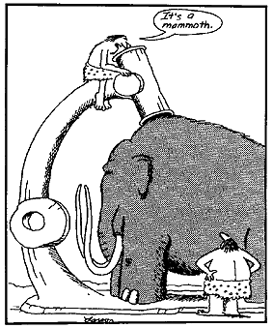
Thinking Cap
Why might we know SO much more about the microscopic world today, compared to pre-microscope times?

Slide 6
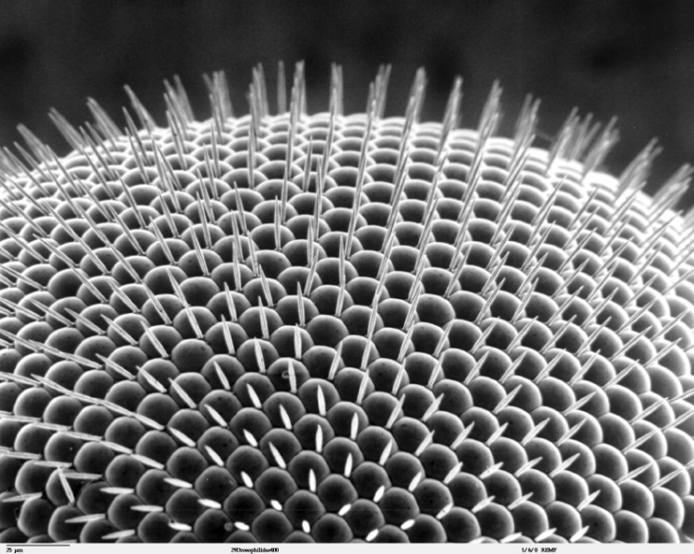
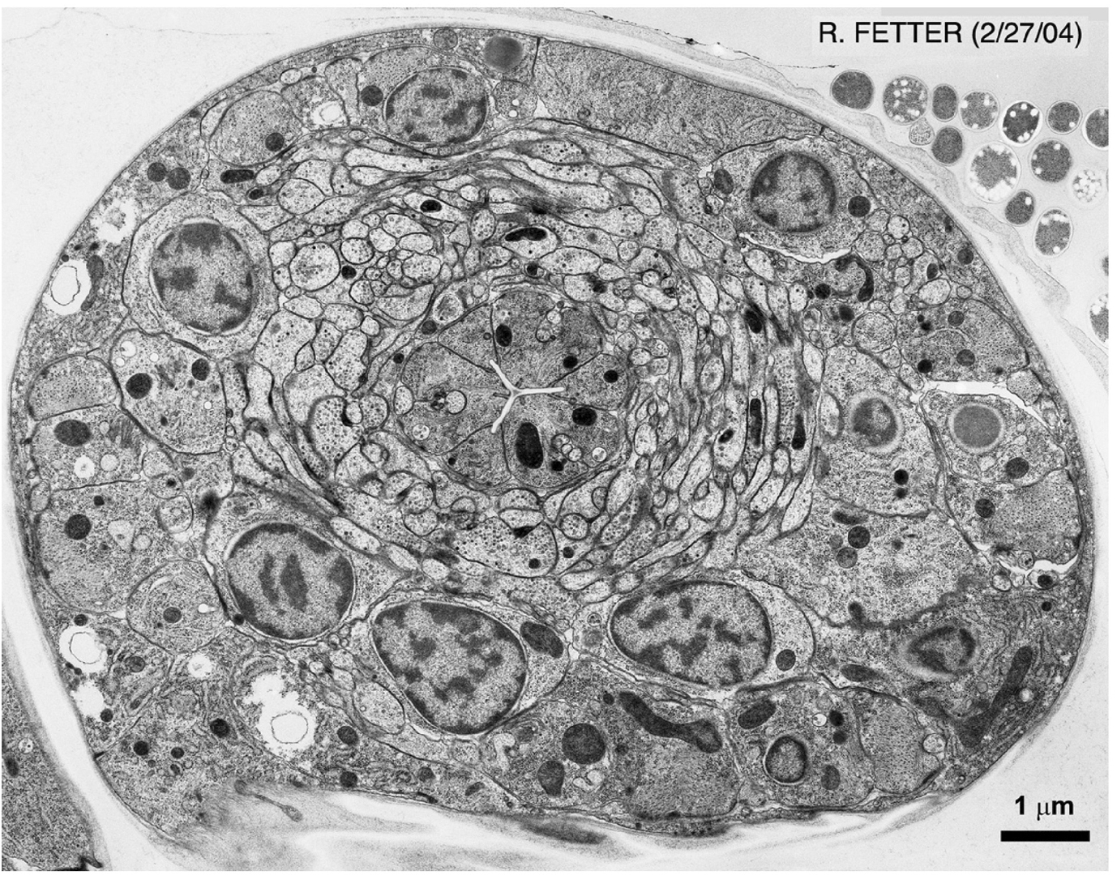
Fancier Microscopes
Electron Microscopes
SEM (s = scanning)
To scan 3D surface of cells
TEM (t = transmission)
To transmit info about structures within the cell

Slide 7
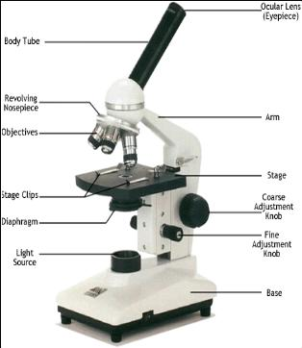
Less Fancy (but still really cool) COMPOUND LIGHT MICROSCOPE

Slide 8
Functions of Parts
Ocular lens = what you look through
The eyepiece holds the ocular lens
Try to keep both eyes open, but don’t worry if you can’t
Body Tube = connects the ocular lens with the stage
Nose piece = holds the 3 objective lenses
Rotates so that you can control which lens to use
Make sure the shortest objective is “in place” when you put your microscope away!
Stage (+clips) = holds your slide in place!
Use the clips only when you’ve found the specimen
Don’t use the clips with a wet mount slide!

Slide 9
Parts of the ‘scope - this will go on 7L

Slide 10
Functions of Parts (cont.)
Diaphragm = lets light in
You can control the amount of light let in! woo!
Light source = light that illuminates your specimen
Use the diaphragm to control the amount (see Troubleshooting)
Course Adjustment Knob = move stage up and down
It’s the fat one!
Use first, to find your specimen
Fine Adjustment Knob = finely adjusts the focus
It’s the skinny one!
Use second, to find more detail(s) on your specimen

Slide 11
Parts of the ‘scope - this will go on 7L

Slide 12
More about the objectives
3 magnifications:
Scanning – used to find the specimen!
Low Power – used to focus on the specimen!
High Power – used to find detail on the specimen!
 | Magnification | Ocular Lens | Total Magnification
Scanning | 4x | 10x | 40x
Low Power | 10x | 10x | 100x
High Power | 40x | 10x | 400x

Slide 13
Thinking Cap
What is the relationship between the Total Magnification and the magnification of the objective?
 | Magnification | Ocular Lens | Total Magnification
Scanning | 4x | 10x | 40x
Low Power | 10x | 10x | 100x
High Power | 40x | 10x | 400x

Slide 14
General Procedure
Plug microscope in & turn on light source
Place slide on stage
With your scanning objective in place and your eye looking into the eyepiece, use the course adjustment to move the stage to a place where you can find the specimen
Switch to Low Power to focus on your specimen, using the fine adjustment

Slide 15
Hey Mrs. A!
SHOW THE VIDEO NOW ;)
https://www.youtube.com/watch?v=scEhgAiazzU

Slide 16
ALWAYS:
Carry your microscope by the arm AND the base
yes you need both hands!
Set the microscope down gently
this goes for moving the microscope around on the surface, as well (don’t drag it around)
Start with the 4x objective
Build up to the fancy-pants higher objectives after you’ve found your specimen!

Slide 17
NEVER:
Be anything but focused and “heads up” when holding / carrying the microscope
* $$$
“Zoom in” so much that your objectives touch the slide
* this can crack the slide and/or ruin the lens on the objective ☹
Use the coarse adjustment when focusing on the medium and high power objectives!!!!!
* This makes #2 very easy to do, and we don’t want to do that!

Slide 18
How to Stain a Slide
Place 1 drop of stain on the edge of the coverslip
Place the flat edge of a piece of paper towel on the opposite side of the coverslip
The paper will draw the water out from under the coverslip and therefore the stain, too!
As long as the stain covers your whole specimen, you’re done!
Add ½ drops until this is the case, using step #2
Wipe off excess stain with a paper towel

Slide 19
Thinking Cap?
Why does your textbook show all the parts of the cell fancy colors and shapes? Will you be able to see that when you look in the microscope?

Slide 21
Troubleshooting
If your specimen is too light or too dark ?
Try adjusting the diaphragm
If there is a spot / line in the viewing field ?
Either rotate the eyepiece (the line is a pointer!) OR
Use a lens wipe to clean the lens of the objective
If it looks like a half-moon instead of a full moon?
Try clicking your objective all the way into place!

Slide 22
On your Lab Report
Always label!
Specimen name
Magnification
Always draw your observations in pencil
Inside the circle = inside the viewing field of the microscope … should be drawn to scale!
Always follow directions!
If you’re asked to draw JUST ONE CELL, you should draw JUST ONE CELL!

