Slide 1
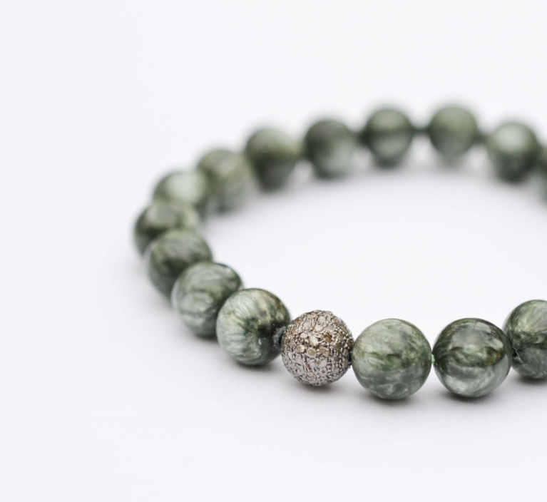
Warm Up (top of 3R)
FIRST – draw the bracelet, then answer the questions!
1. What is the “bracelet” called? (hint: made up of MANY parts)
2. What is 1 subunit of a macromolecule called?
4. If these “beads” are all amino acids, what type of “bracelet” are we looking at?
3. What is the process of making the “bracelet” called? (hint: stringing the beads together)

Slide 2
Enzymes!
3R

Slide 3
One type of protein is an ENZYME
Enzymes are important PROTEINS found in all living things. They change the rate of chemical reactions.
Example: Some enzymes help to speed up the digestion of our food.
The name of many enzymes ends in -ase:
Ex: salivary amylase, protease, etc.

Slide 4
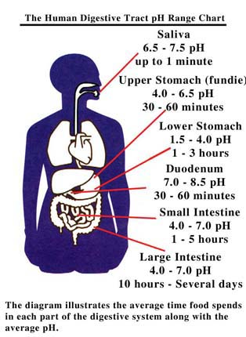
Thinking Cap
Why is it important that food gets digested quickly?
What would happen if our enzymes got damaged and couldn’t speed up reactions like digestion?

Slide 5
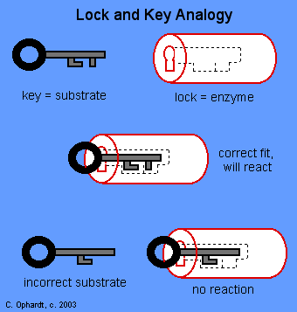
So how do enzymes work?
They work like a lock and key
Important terms:
The molecules that interact with the enzymes are called the substrates.
The new substances formed by the chemical reaction are called the products.
Video!!!

Slide 6
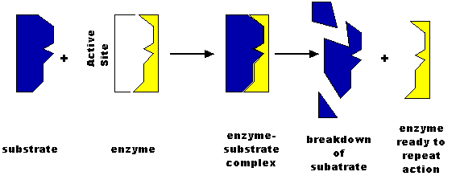
Digestion: whole food
goes in, is broken down,
& macromolecules are
extracted for use by the body
(PRODUCTS)
(This is where Mrs. A should show the video! https://www.youtube.com/watch?v=bNMsNHqxszc)

Slide 7
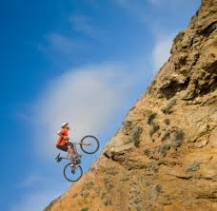
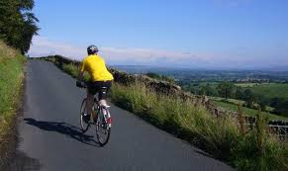
Enzymes also
Lower the activation energy of a reaction
in order to
Increase the rate of reaction!
Which hill is easier to get up?

Slide 8
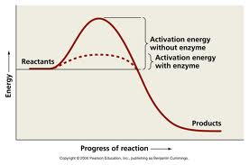
HOW enzymes speed up chemical reactions
Thinking Cap: What is one difference you notice between the reaction with an enzyme vs. the reaction without an enzyme?
Video clip!!!

Slide 9
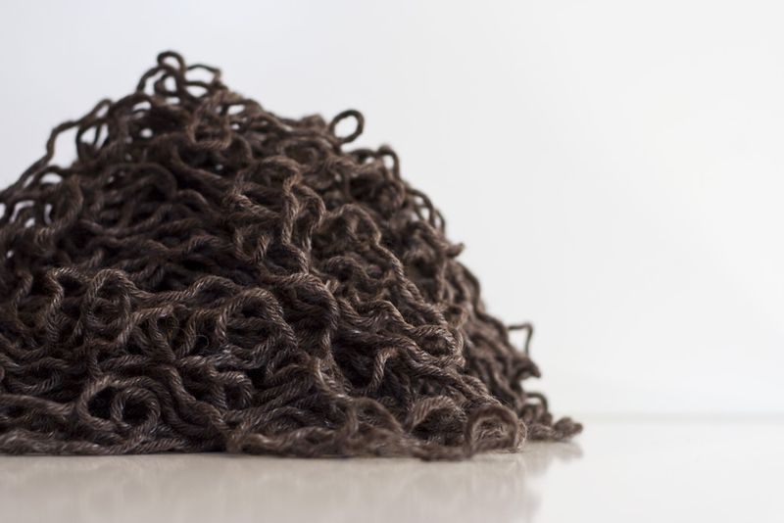
What can happen to enzymes (& other proteins)
If you change:
pH (more acidic or more basic)
Temperature (hotter or colder)
Concentrations (more or less substrate)
Then your protein won’t work as well, or even not at all… this is because it will DENATURE (=unravel!!!)

Slide 10
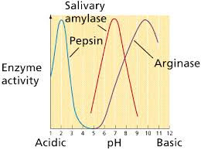
Thinking Cap
Could an enzyme from your mouth (pH=7) function in your stomach (pH=2) ? Why / why not? Explain…

Slide 11
Enzymes in Industry

Slide 12
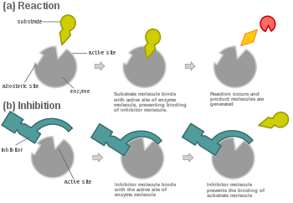
Enzyme Inhibitors
Sometimes we need Enzymes to stop doing their jobs so well!
ex: killing bacteria that are killing our cells
Basically: Enzyme Inhibitors BLOCK substrates from binding to the Active Site of the enzyme

