Slide 1
College Physics, Chapter 10 Standard Level Physics, Chapter 3
Thermal Physics

Slide 2
States of Matter
Solid
Liquid
Gas
Plasma

Slide 3
Solids
Has definite volume
Has definite shape
Molecules are held in specific locations
by electrical forces
vibrate about equilibrium positions
Can be modeled as springs connecting molecules

Slide 4
Liquid
Has a definite volume
No definite shape
Exists at a higher temperature than solids
The molecules “wander” through the liquid in a random fashion
The intermolecular forces are not strong enough to keep the molecules in a fixed position

Slide 5
Gas
Has no definite volume
Has no definite shape
Molecules are in constant random motion
The molecules exert only weak forces on each other
Average distance between molecules is large compared to the size of the molecules

Slide 6
Plasma
Matter heated to a very high temperature
Many of the electrons are freed from the nucleus
Result is a collection of free, electrically charged ions
Plasmas exist inside stars

Slide 7
In groups of 2 or 3, take turns sharing about the SHAPE and VOLUME of
Solids
Liquids
Gases

Slide 8
Energy Transfer
When two objects of different temperatures are placed in thermal contact, the temperature of the warmer decreases and the temperature of the cooler increases
The energy exchange ceases when the objects reach thermal equilibrium
The concept of energy was broadened from just mechanical to include internal
Made Conservation of Energy a universal law of nature

Slide 9
Heat Compared to Internal Energy
Important to distinguish between them
They are not interchangeable
They mean very different things when used in physics

Slide 10
Internal Energy
Internal Energy, U, is the energy associated with the microscopic components of the system
Includes kinetic and potential energy associated with the random translational, rotational and vibrational motion of the atoms or molecules
Also includes any potential energy bonding the particles together

Slide 11
Heat
Heat is the transfer of energy between a system and its environment because of a temperature difference between them
The symbol Q is used to represent the amount of energy transferred by heat between a system and its environment

Slide 12
Methods of Heat Transfer
Need to know the mechanisms responsible for the transfer (this is covered in chapter 8)
Methods include
Conduction
Convection
Radiation

Slide 13
Thermal Equilibrium
Two objects in thermal equilibrium with each other are at the same temperature
Temperature is the property that determines whether or not an object is in thermal equilibrium with other objects

Slide 14
Thermometers
Used to measure the temperature of an object or a system
Make use of physical properties that change with temperature
Many physical properties can be used
volume of a liquid
length of a solid
pressure of a gas held at constant volume
volume of a gas held at constant pressure
electric resistance of a conductor
color of a very hot object

Slide 15
Celsius Scale
Temperature of an ice-water mixture is defined as 0º C
This is the freezing point of water
Temperature of a water-steam mixture is defined as 100º C
This is the boiling point of water
Distance between these points is divided into 100 segments or degrees

Slide 16
Kelvin Scale
When the pressure of a gas goes to zero, its temperature is –273.15º C
This temperature is called absolute zero
This is the zero point of the Kelvin scale
–273.15º C = 0 K
To convert: T_{C} = T_{K} – 273.15
The size of the degree in the Kelvin scale is the same as the size of a Celsius degree

Slide 17
Pressure-Temperature Graph
All gases extrapolate to the same temperature at zero pressure
This temperature is absolute zero

Slide 18
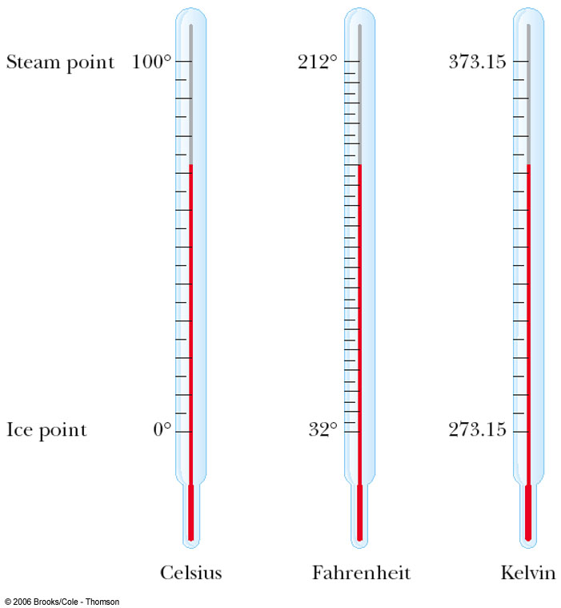
Comparing Temperature Scales

Slide 19
Converting Among Temperature Scales

Slide 20
Example
The distance between the 0°C and 100°C marks on a mercury-in-glass thermometer is 20 cm. When the thermometer bulb is placed in a mixture of ice and salt, the mercury level is 4 cm below the 0°C mark. The temperature of the mixture is
A. +20°C.
B. +5°C.
C. –5°C.
D. –20°C.

Slide 21
Thermal Capacity
Every substance requires a unique amount of energy to change the temperature of that substance by 1° C
The thermal capacity, C, of a substance is a measure of this amount

Slide 22
Specific Heat Capacity
Every substance requires a unique amount of energy per unit mass to change the temperature of that substance by 1° C
The specific heat capacity, c, of a substance is a measure of this amount

Slide 23
Units of Specific Heat
SI units
J / kg °C
Historical units
cal / g °C

Slide 24
Heat and Specific Heat
Q = m c ΔT
ΔT is always the final temperature minus the initial temperature
When the temperature increases, ΔT and ΔQ are considered to be positive and energy flows into the system
When the temperature decreases, ΔT and ΔQ are considered to be negative and energy flows out of the system

Slide 25
Example
The heat capacity of a solid body is defined as
A. the thermal energy required to increase the body’s temperature by one degree.
B. the maximum thermal energy that must be supplied to melt the solid.
C. the total kinetic energy of the solid’s molecules.
D. the average kinetic energy of the solid’s molecules.

Slide 26
Calorimeter
One technique for determining the specific heat of a substance
A calorimeter is a vessel that is a good insulator which allows a thermal equilibrium to be achieved between substances without any energy loss to the environment

Slide 27
Calorimetry
Analysis performed using a calorimeter
Conservation of energy applies to the isolated system
The energy that leaves the warmer substance equals the energy that enters the water
Q_{cold} = -Q_{hot}
Negative sign keeps consistency in the sign convention of ΔT

Slide 28
Calorimetry with More Than Two Materials
In some cases it may be difficult to determine which materials gain heat and which materials lose heat
You can start with ΣQ = 0
Each Q = m c ΔT
Use T_{f} – T_{i}
You don’t have to determine before using the equation which materials will gain or lose heat

Slide 29
Phase Changes
A phase change (or change of state) occurs when the physical characteristics of the substance change from one form to another
Common phases changes are
Solid to liquid – melting
Liquid to gas – vaporisation
Phases changes involve a change in the internal energy, but no change in temperature (change in PE, but not KE)

Slide 30
Specific Latent Heat
L is the specific latent heat of the substance
Latent means hidden
L depends on the substance and the nature of the phase change

Slide 31
Latent Heat, cont.
SI units of latent heat are J / kg
Latent heat of fusion, L_{f}, is used for melting or freezing
Latent heat of vaporization, L_{v}, is used for vaporising or condensing

Slide 32
Example
The specific latent heat of fusion of a substance is the quantity of thermal energy required to convert, at constant temperature,
A. a solid to a liquid.
B. unit mass of solid to liquid.
C. a liquid to a solid.
D. unit mass of liquid to solid.
Notes:
B

Slide 33
Sublimation
Some substances will go directly from solid to gaseous phase
Without passing through the liquid phase
This process is called sublimation
There will be a latent heat of sublimation associated with this phase change

Slide 34
Vaporisation
There are two different processes by which liquids can change to gases
Boiling
Evaporation
Rate increased by
Increasing surface area
Increasing air movement across surface
Increasing temperature of liquid

Slide 35
Example
Which of the following will not affect the rate of evaporation of a liquid?
A. The temperature of the liquid
B. The surface area of the liquid
C. The mass of the liquid
D. Convection currents of air above the liquid surface

Slide 36
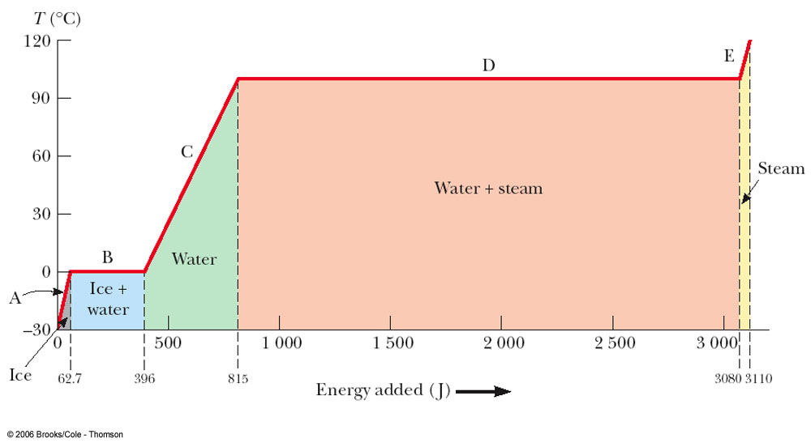
Graph of Ice to Steam

Slide 37
Warming Ice
Start with one gram of ice at –30.0º C
During A, the temperature of the ice changes from –30.0º C to 0º C
Use Q = m c ΔT
Will add 62.7 J of energy

Slide 38
Melting Ice
Once at 0º C, the phase change (melting) starts
The temperature stays the same although energy is still being added
Use Q = m L_{f}
Needs 333 J of energy

Slide 39
Warming Water
Between 0º C and 100º C, the material is liquid and no phase changes take place
Energy added increases the temperature
Use Q = m c ΔT
419 J of energy are added

Slide 40
Boiling Water
At 100º C, a phase change occurs (boiling)
Temperature does not change
Use Q = m L_{v}
2 260 J of energy are needed

Slide 41
Heating Steam
After all the water is converted to steam, the steam will heat up
No phase change occurs
The added energy goes to increasing the temperature
Use Q = m c ΔT
To raise the temperature of the steam to 120°, 40.2 J of energy are needed

Slide 42
Example
Temperature is the only property that determines
A. the total internal energy of a substance.
B. the phase (state) of a substance.
C. the direction of thermal energy transfer between two bodies in thermal contact.
D. the process by which a body loses thermal energy to the surroundings.

Slide 43
The Mole
A mole of any material contains 6.022 x 10²³ atoms or molecules.
6.022 x 10²³ is known as Avogadro’s number.
It’s like going to the doughnut shop and ordering a dozen.
A mole of carbon doesn’t have the same mass as a mole of neon, just like a dozen doughnut holes won’t have the same mass as a dozen bear claws.

Slide 44
The Mole
$$n=\frac{N}{N_{A}}$$
n is the number of moles
N is the number of molecules
N_{A} is Avogadro’s number

Slide 45
Ideal Gas
A gas does not have a fixed volume or pressure
In a container, the gas expands to fill the container
Most gases at room temperature and pressure behave approximately as an ideal gas

Slide 46
Characteristics of an Ideal Gas
Collection of atoms or molecules that move randomly
Exert no long-range force on one another
Each particle is individually point-like
Occupying a negligible volume

Slide 47
Kinetic Theory of Gases – Assumptions
The number of molecules in the gas is large and the average separation between them is large compared to their dimensions
The molecules obey Newton’s laws of motion, but as a whole they move randomly

Slide 48
Kinetic Theory of Gases – Assumptions, cont.
The molecules interact only by short-range forces during elastic collisions
The molecules make elastic collisions with the walls
The gas under consideration is a pure substance, all the molecules are identical

Slide 49
Pressure
The force exerted by a fluid on a submerged object at any point if perpendicular to the surface of the object

Slide 50
Pressure of an Ideal Gas
The pressure is proportional to the number of molecules per unit volume and to the average translational kinetic energy of a molecule
$$P=\frac{2}{3}\left(\frac{N}{V}\right)\left(\frac{1}{2}m\overline{c^{2}}\right)$$

Slide 51
Pressure
Pressure can be increased by
Increasing the number of molecules per unit volume in the container
Increasing the average translational kinetic energy of the molecules
Increasing the temperature of the gas

Slide 52
Molecular Interpretation of Temperature
Temperature is proportional to the average kinetic energy of the molecules

Slide 53
Example
The kelvin temperature of an object is a measure of
A. the total energy of the molecules of the object.
B. the total kinetic energy of the molecules of the object.
C. the maximum energy of the molecules of the object.
D. the average kinetic energy of the molecules of the object.

Slide 54
Internal Energy
In a monatomic gas, the KE is the only type of energy the molecules can have
total internal energy of an ideal gas
In a polyatomic gas, additional possibilities for contributions to the internal energy are rotational and vibrational energy in the molecules

Slide 55
Speed of the Molecules
Expressed as the root-mean-square (rms) speed
At a given temperature, lighter molecules move faster, on average, than heavier ones
Lighter molecules can more easily reach escape speed from the earth

Slide 56
Ideal Gas Law
PV = n R T
R is the Universal Gas Constant
R = 8.31 J / mole.K
R = 0.0821 L. atm / mole.K
Is the equation of state for an ideal gas

Slide 57
Work in a Gas Cylinder
The gas is contained in a cylinder with a moveable piston
The gas occupies a volume V and exerts pressure P on the walls of the cylinder and on the piston

Slide 58
Work in a Gas Cylinder, cont.
A force is applied to slowly compress the gas
Pressure and temperature increase
This is the work done on the gas
A gas expands, pushing a piston up
Pressure and temperature decrease
This is the work done by the gas

Slide 59
Example
A fixed quantity of an ideal gas is compressed at constant temperature. The best explanation for the increase in pressure is that the molecules
A. are moving faster.
B. are colliding more frequently with the container walls.
C. exert greater forces on each other.
D. are colliding more frequently with each other.

