Slide 1
THERMOCHEMISTRY

Slide 2
Definitions #1
Energy: The capacity to do work or produce heat
Potential Energy: Energy due to position or composition
Kinetic Energy: Energy due to the motion of the object

Slide 3
Definitions #2
Law of Conservation of Energy: Energy can neither be created nor destroyed, but can be converted between forms
The First Law of Thermodynamics: The total energy content of the universe is constant

Slide 4
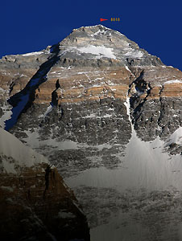
State Functions
A state function depends ONLY on the present state of the system
ENERGY IS A STATE FUNCTION
A person standing at the top of Mt. Everest has the same potential energy whether they got there by hiking up, or by falling down from a plane!

Slide 5
Energy Change in Chemical Processes
Endothermic:
Reactions in which energy flows into the system as the reaction proceeds.
+ ΔH_{system}
- DH_{surroundings}
Exothermic:
Reactions in which energy flows out of the system as the reaction proceeds.
- ΔH_{system}
+ DH_{surroundings}

Slide 6
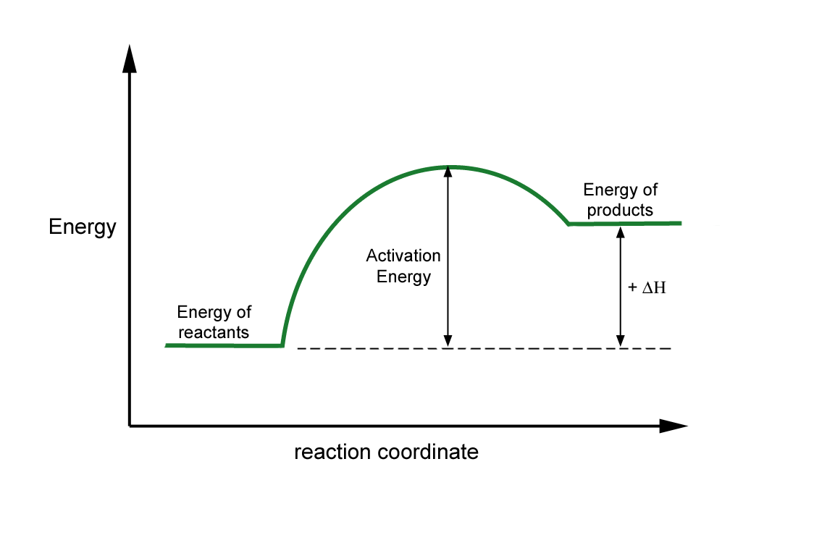
Endothermic Reaction

Slide 7
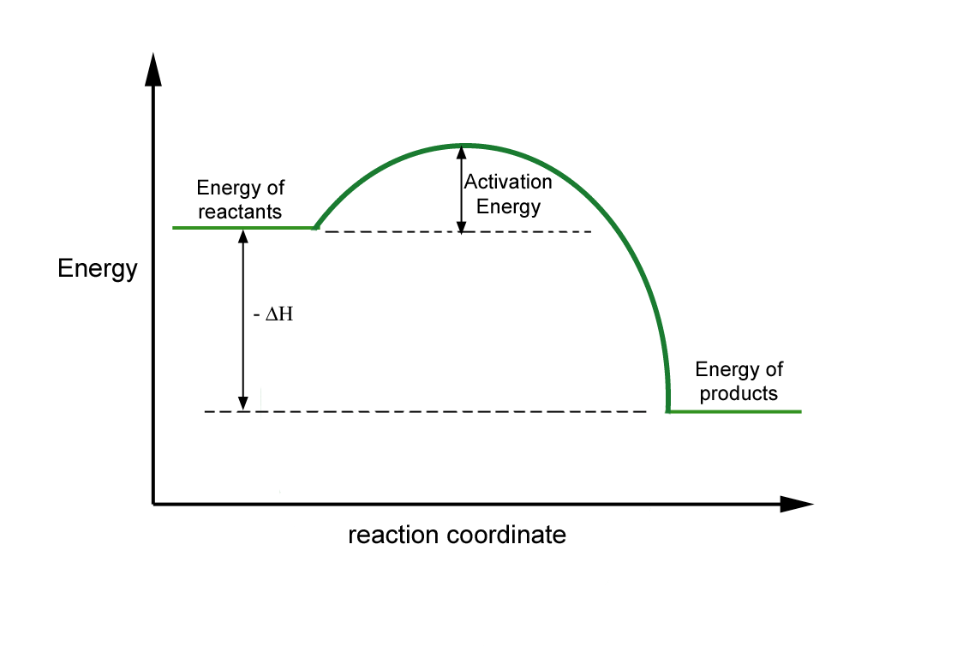
Exothermic Reaction

Slide 8
Calorimetry
The amount of heat absorbed or released during a physical or chemical change can be measured…
…usually by the change in temperature of a known quantity of water
1 calorie is the heat required to raise the temperature of 1 gram of water by 1 °C
1 BTU is the heat required to raise the temperature of 1 pound of water by 1 °F

Slide 9
The Joule
The unit of heat used in modern thermochemistry is the Joule
4.184 joule = 1 calories

Slide 10
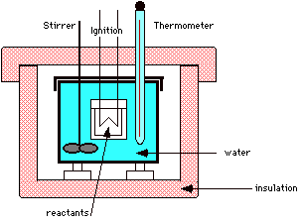
A Bomb Calorimeter

Slide 11
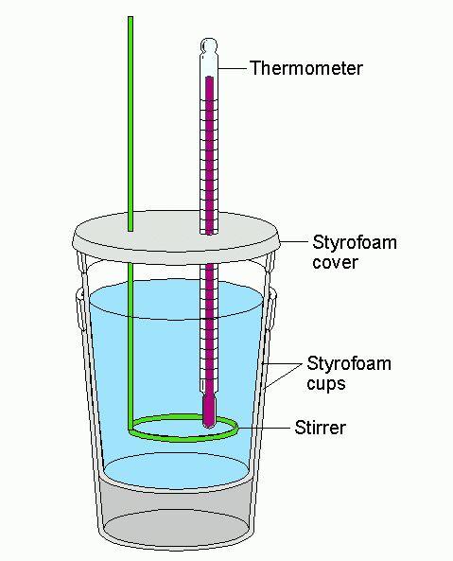
A Cheaper Calorimeter

Slide 12
Specific Heat
The amount of heat required to raise the temperature of one gram of substance by one degree Celsius.
Substance | Specific Heat (J/g·K)
Water (liquid) | 4.18
Ethanol (liquid) | 2.44
Water (solid) | 2.06
Water (vapor) | 1.87
Aluminum (solid) | 0.897
Carbon (graphite,solid) | 0.709
Iron (solid) | 0.449
Copper (solid) | 0.385
Mercury (liquid) | 0.140
Gold (solid) | 0.129
Lead (solid) | 0.129

Slide 13
Calculations Involving Specific Heat
OR
S or C_{p} = Specific Heat Capacity
ΔH = Heat lost or gained
ΔT = Temperature change

Slide 14
Sample Problem 1
A 70.00g sample of metal is heated to 80.0°C and placed in 100.00g of water at 22.0°C in a styrofoam cup. The temperature of the water in the cup rises to 26.4°C as the metal cools. Determine the specific heat of the metal.
Mass of metal = 70.00g ∆T of metal = 53.6°C
Heat gained by water = (mass of water)(ΔT of water)(Cp of water)
Heat = (100.00g)(4.4°C)(4.184 J/g °C) = 1840.96J = 1800J
Heat gained by the water = Heat lost by the metal
To find specific heat remember the units: C_{p} = J/g ·°C

Slide 15
Heat of Combustion
CH₄ + 2O₂ → CO₂ + 2H₂O ΔH= -891 KJ
Calculate the enthalpy change when 1.00 g of methane reacts with excess oxygen gas.
Answer = -55.5 KJ

Slide 16
H⁺ + OH⁻ → H₂0
Suppose 50.0 ml of 1.0M HCl at 25ºC is mixed w/ 50.0 ml of NaOH at 25ºC in a colorimeter. After the reactants are mixed the temperature rises to 31.0 ºC. What is the Δ H of the reaction?
Delta T = 6.9ºC
Mass of solution is 100.0 mL or 100.0 g
Specific heat of water = 4.18 J/g ºC
ΔH= 4.18 J / 100.0 g / 6.9 ºC
g ºC /
ΔH=s m Δt
ΔH = 2900 J

Slide 17
Hess’s Law
“In going from a particular set of reactants to a particular set of products, the change in enthalpy is the same whether the reaction takes place in one step or a series of steps.”

Slide 18
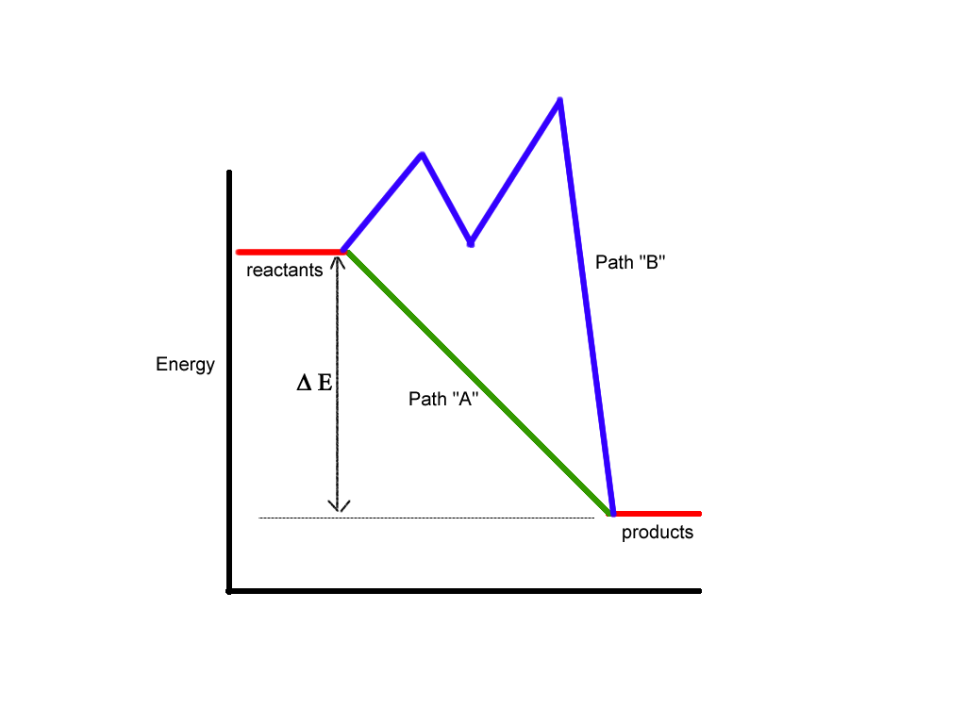
Hess’s Law

Slide 19
Hess’s Law Example Problem
Calculate ΔH for the combustion of methane, CH₄: CH₄ + 2O₂ → CO₂ + 2H₂O
Reaction | ΔHº
C + 2H₂ → CH₄ | -74.80 kJ
C + O₂ → CO₂ | -393.50 kJ
H₂ + ½ O₂ → H₂O | -285.83 kJ
CH₄ → C + 2H₂ +74.80 kJ
C + O₂ → CO₂ -393.50 kJ
2H₂ + O₂ → 2 H₂O -571.66 kJ
CH₄ + 2O₂ → CO₂ + 2H₂O
-890.36 kJ
Step #1: CH₄ must appear on the reactant side, so we reverse reaction #1 and change the sign on ΔH.
Step #2: Keep reaction #2 unchanged, because CO₂ belongs on the product side
Step #3: Multiply reaction #3 by 2
Step #4: Sum up reaction and ΔH

Slide 20
Calculation of Heat of Reaction
Calculate ΔH for the combustion of methane, CH₄: CH₄ + 2O₂ → CO₂ + 2H₂O
ΔH_{rxn} = Σ ΔH_{f}(products) - Σ Δ H_{f}(reactants)
Substance | ΔH_{f}
CH₄ | -74.80 kJ
O₂ | 0 kJ
CO₂ | -393.50 kJ
H₂O | -285.83 kJ
ΔH_{rxn} = [-393.50kJ + 2(-285.83kJ)] – [-74.80kJ + 0]
ΔH_{rxn} = -890.36 kJ

