Slide 1
Five Experiments You Should Know
By: Christian Squire
Pd. 6

Slide 2
J. J. Thomson’s Cathode Ray
English physicist J. J. Thomson studied electrical discharges in partially evacuated tubes called cathode-ray tubes. He found that when high voltage was applied to the tube, a “ray” he called a cathode ray was produced. Because the ray was produced at the negative electrode and was repelled by the negative pole of an applied electric field, Thomson postulated that the ray was a stream of negatively charged particles, now called electrons. He reasoned that since the electrons could be produced from electrodes made of various types of metals, all atoms must contain electrons. Since atoms were known to be electrically neutral, Thomson further assumed that atoms also must contain some positive charge. He postulated that an atom consisted of a diffuse cloud of positive charge with the negative electrons randomly in it. This model is often called the plum pudding model.

Slide 3
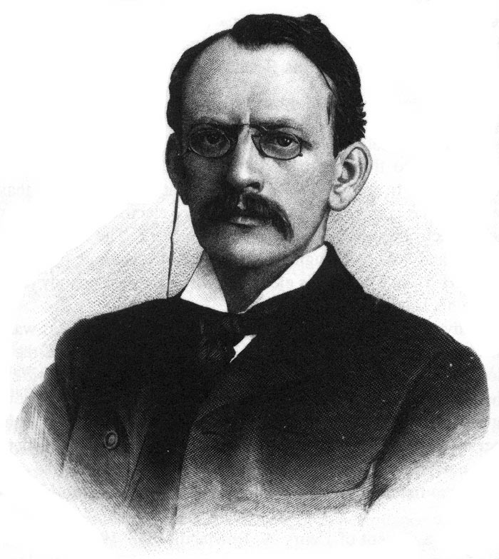
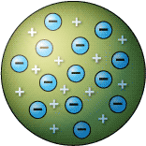
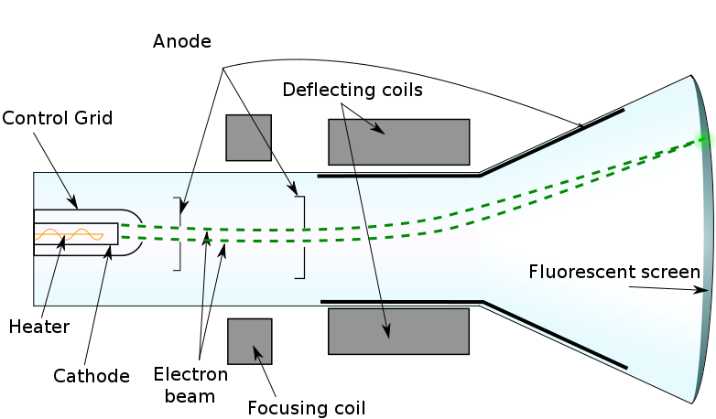

Slide 4
Robert Millikan’s Oil Drop Experiment
Robert Millikan formed clever experiments involving charged oil drops. These experiments allowed him to determine the magnitude of the electron charge. With this volume and the charge-to-mass ratio (determined by Thomson to be electron charge/electron mass = -1.76x10^8 coulombs/grams), Millikan was able to calculate the mass of the electron as 9.11x10^-31 kg.

Slide 5
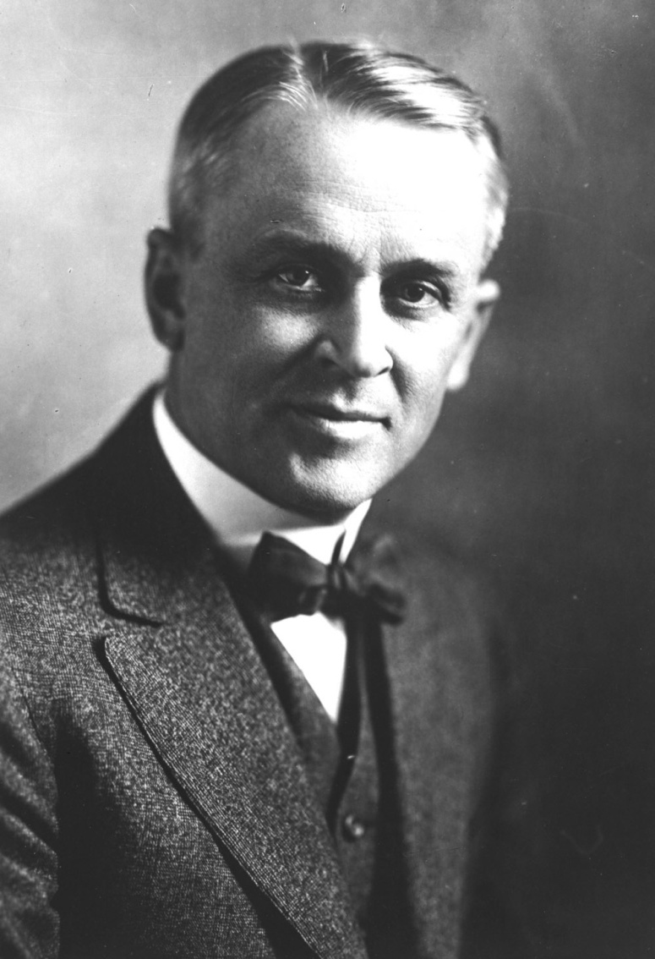
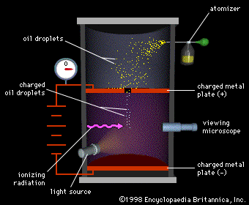

Slide 6
Ernest Rutherford’s Nuclear Atom
Ernest Rutherford carried out an experiment to test Thomson’s plum pudding model. The experiment involved directing alpha particles at a thin sheet of metal foil. He reasoned that if Thomson’s model was correct, the alpha particles should crash right through the foil with very minor deflections in their paths. However, Rutherford found that many of the particles were deflected at large angles and some were reflected, never hitting the detector. The large deflections of the alpha particles could be caused only by a center of concentrated positive charge that contains most of the atom’s mass. Most of the particles passed directly through the foil because the atom is mostly open space. He explained this through the nuclear atom model-an atom with a dense center of positive charge (the nucleus) with electrons moving around the nucleus at a distance that is large relative to the nuclear radius.

Slide 7
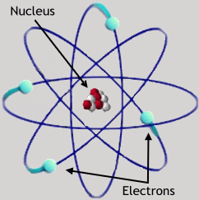
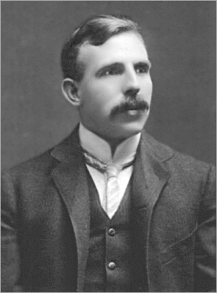
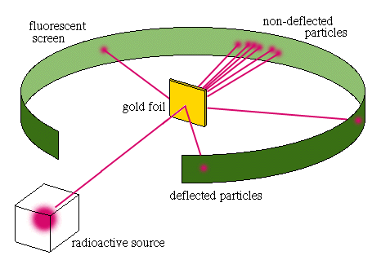

Slide 8
Niel Bohr’s Model
Niel Bohr Bohr model depicts the atom as a small, positively charged nucleus surrounded by electrons that travel in circular orbits around the nucleus. Coulombic forces provided attraction between the electrons and the nucleus—much like how the planets in the solar system are kept in its orbits by gravity. He developed this idea through a quantum model for the hydrogen atom. This was an improvement on the earlier cubic model, the plum-pudding model, the Saturnian model, and the Rutherford model. Since the Bohr model is a quantum physics-based modification of the Rutherford model, many sources combine the two, referring to the Rutherford–Bohr model.

Slide 9
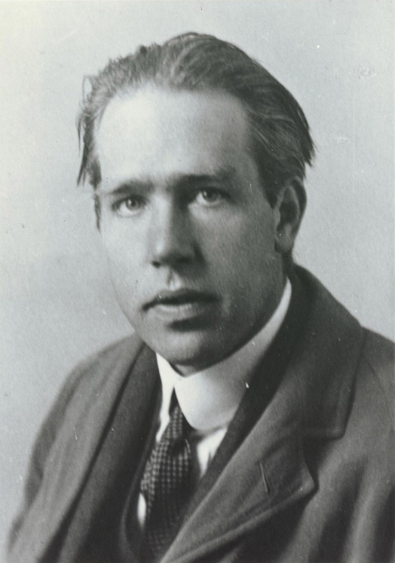
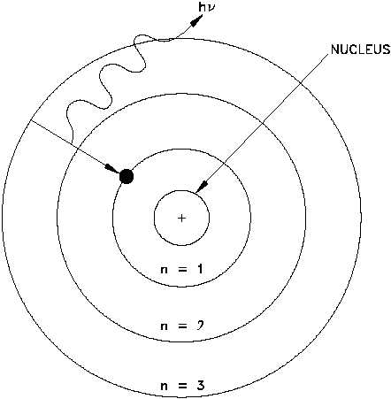

Slide 10
Albert Einstein’s Photoelectric Effect
Albert Einstein proposed that electromagnetic radiation is quantized (consists of photons). He suggested that electromagnetic radiation can be viewed as a stream of “particles” called photons. He arrived at this conclusion though his analysis of the photoelectric effect. This refers to the phenomenon in which electrons are emitted from the surface of a metal when light strikes it. The following observations characterized the photoelectric effect:
Studies in which the frequency of the light is varied show that no electrons are emitted by a given metal below a specific threshold frequency.
For light with frequency lower than the threshold frequency, no electrons are emitted regardless of the intensity of the light.
For light with frequency greater than the threshold frequency, the number of electrons emitted increases with the intensity of the light.
For light with frequency greater than the threshold frequency, the kinetic energy, of the emitted electrons increases linearly with the frequency of the lights.
These observations can be explained by assuming that electromagnetic radiation is quantized, and that the threshold frequency represents the minimum energy required to remove the electron from the metal’s surface.

Slide 11
