Slide 1
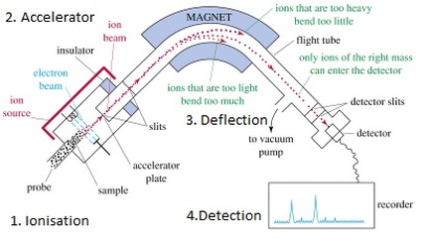
Average Atomic Mass Warm-up

Slide 2
Calculate the average atomic mass for oxygen. Isotope information is provided below. Show all of your work and check your answer against the mass listed on the periodic table.
Isotope | Natural Abundance on Earth (%) | Atomic Mass (amu)
16O | 99.76 | 15.9949
17O | 0.04 | 16.9991
18O | 0.20 | 17.9992

