Slide 1
Potions & Poisons

Slide 2
Poison Ivy

Slide 3
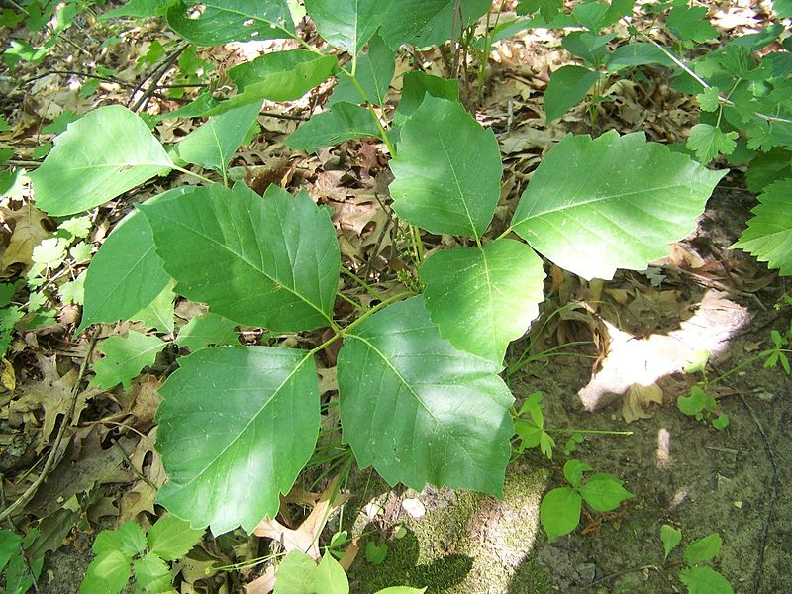
Notes:
"Poison Ivy in Perrot State Park" by SWMNPoliSciProject - Own work. Licensed under Creative Commons Attribution 3.0 via Wikimedia Commons - http://commons.wikimedia.org/wiki/File:Poison_Ivy_in_Perrot_State_Park.jpg#mediaviewer/File:Poison_Ivy_in_Perrot_State_Park.jpg

Slide 4
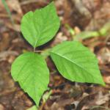
Notes:
http://landscaping.about.com/od/galleryoflandscapephotos/ig/Pictures-of-Poison-Ivy/

Slide 5
Jequirity BeaN

Slide 6
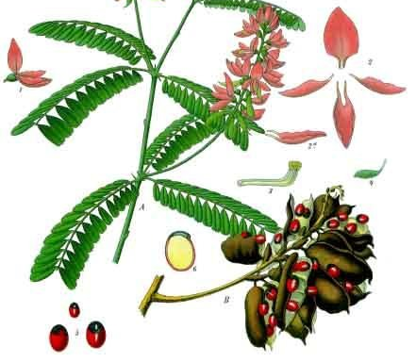
Notes:
"Abrus precatorius - Köhler–s Medizinal-Pflanzen-002" by Franz Eugen Köhler, Köhler's Medizinal-Pflanzen - List of Koehler Images. Licensed under Public domain via Wikimedia Commons - http://commons.wikimedia.org/wiki/File:Abrus_precatorius_-_K%C3%B6hler%E2%80%93s_Medizinal-Pflanzen-002.jpg#mediaviewer/File:Abrus_precatorius_-_K%C3%B6hler%E2%80%93s_Medizinal-Pflanzen-002.jpg
"IndianLicorice 7899" by Primejyothi - Own work. Licensed under Creative Commons Attribution-Share Alike 3.0 via Wikimedia Commons - http://commons.wikimedia.org/wiki/File:IndianLicorice_7899.JPG#mediaviewer/File:IndianLicorice_7899.JPG

Slide 7
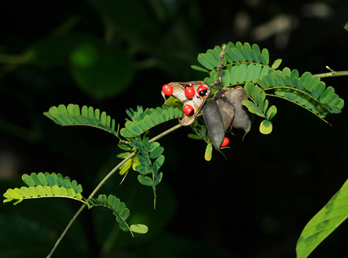
Notes:
wildlifeofhawaii.com

Slide 8
NightShade

Slide 9
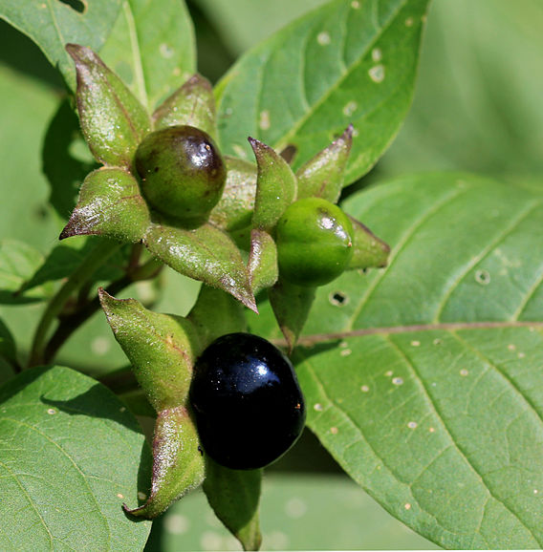
Notes:
"Atropa belladonna Prague 2011 2" by Karelj - Own work. Licensed under Creative Commons Attribution-Share Alike 3.0 via Wikimedia Commons - http://commons.wikimedia.org/wiki/File:Atropa_belladonna_Prague_2011_2.jpg#mediaviewer/File:Atropa_belladonna_Prague_2011_2.jpg

Slide 10
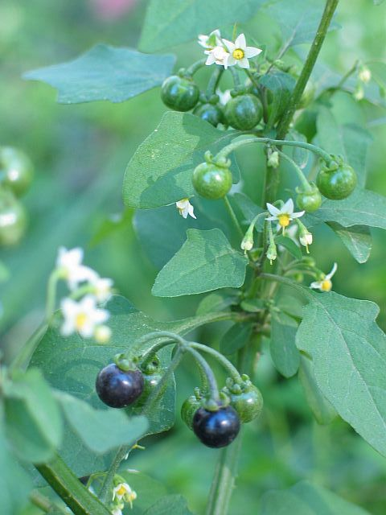
Notes:
www.dpic.org

Slide 11
Foxglove

Slide 12
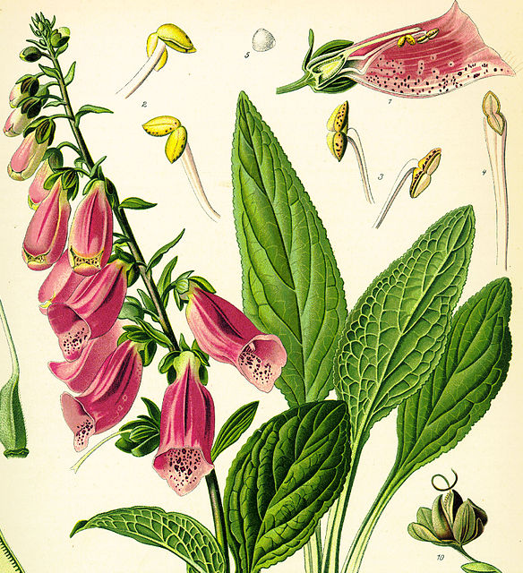
Notes:
"Digitalis purpurea Koehler drawing" by de:Franz Eugen Köhler - http://caliban.mpiz-koeln.mpg.de/koehler/DIGITALIS.jpg. Licensed under Public domain via Wikimedia Commons - http://commons.wikimedia.org/wiki/File:Digitalis_purpurea_Koehler_drawing.jpg#mediaviewer/File:Digitalis_purpurea_Koehler_drawing.jpg

Slide 13
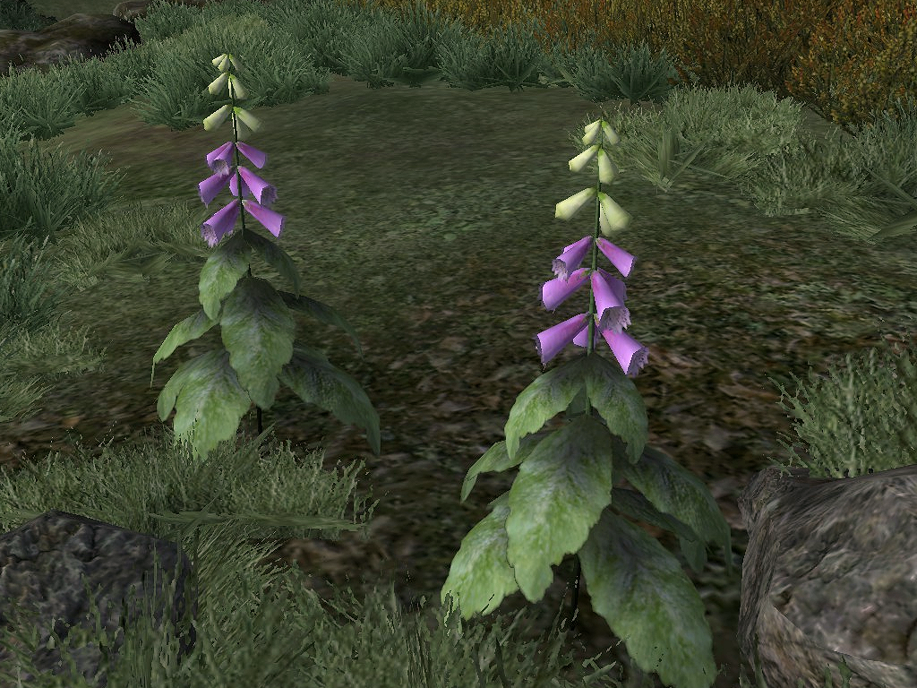
Notes:
elderscrolls.wikia.com

Slide 14
Giant Hogweed

Slide 15
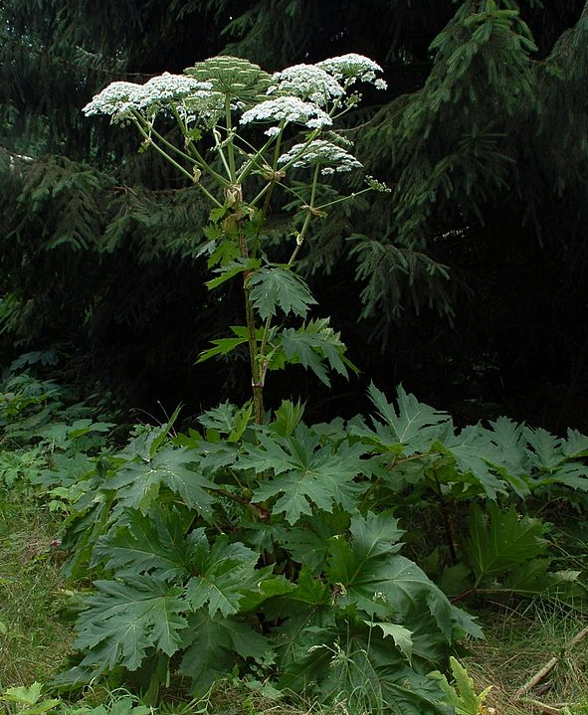
Notes:
"Herkulesstaude fg01" by Fritz Geller-Grimm - Own work. Licensed under Creative Commons Attribution-Share Alike 3.0 via Wikimedia Commons - http://commons.wikimedia.org/wiki/File:Herkulesstaude_fg01.jpg#mediaviewer/File:Herkulesstaude_fg01.jpg

Slide 16
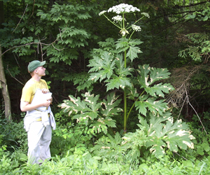
Notes:
www.dec.ny.gov

Slide 17
Rattle Snake

Slide 18
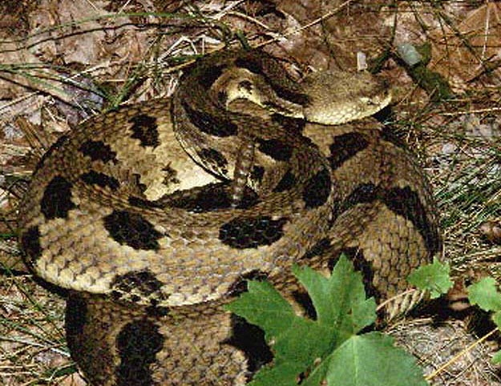
Notes:
http://www.esf.edu/ecenter/eis/images/snakes/timberrattle.jpg

Slide 19
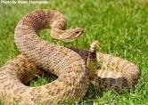
Notes:
gfp.sd.gov

Slide 20
Cottonmouth

Slide 21
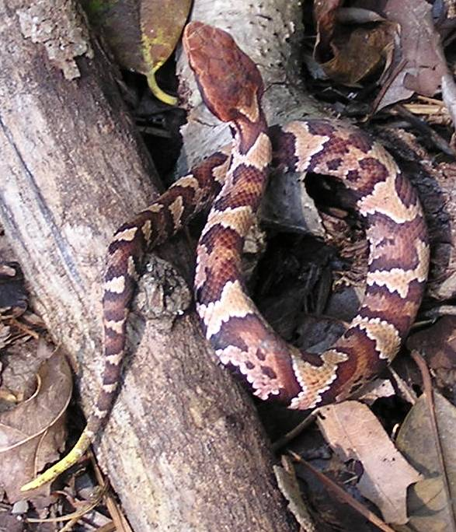
Notes:
"Tiki3 cropped". Licensed under Public domain via Wikimedia Commons - http://commons.wikimedia.org/wiki/File:Tiki3_cropped.jpg#mediaviewer/File:Tiki3_cropped.jpg

Slide 22
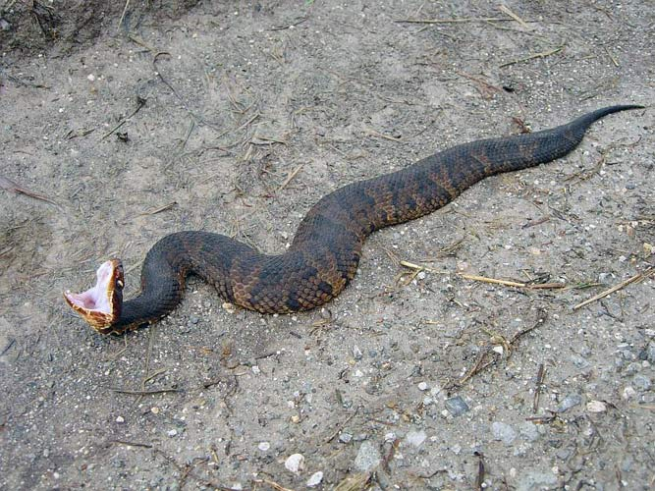
Notes:
www.imgneed.com

Slide 23
Black widow

Slide 24
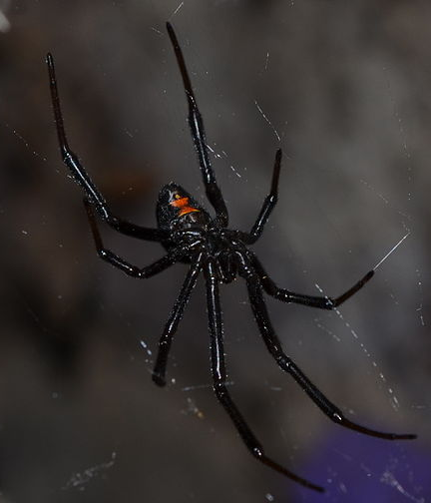
Notes:
"Western Black Widow (Latrodectus hesperus)" by Bloomingdedalus - Own work. Licensed under Creative Commons Attribution-Share Alike 3.0 via Wikimedia Commons - http://commons.wikimedia.org/wiki/File:Western_Black_Widow_(Latrodectus_hesperus).JPG#mediaviewer/File:Western_Black_Widow_(Latrodectus_hesperus).JPG

Slide 25
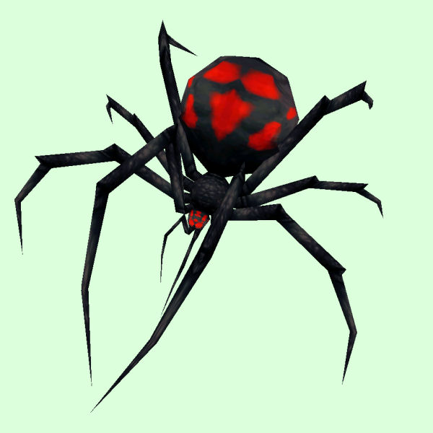
Notes:
www.wow-petopia.com

Slide 26
Brown recluse

Slide 27
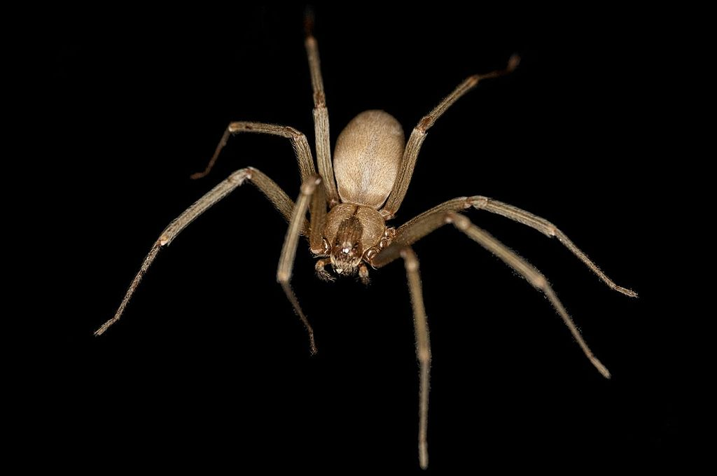
Notes:
"Brown Recluse" by Ladyb695 - Own work. Licensed under Creative Commons Attribution-Share Alike 3.0 via Wikimedia Commons - http://commons.wikimedia.org/wiki/File:Brown_Recluse.jpg#mediaviewer/File:Brown_Recluse.jpg

Slide 28
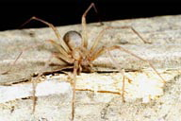
Notes:
http://www.emedicinehealth.com/spider_bite_brown_recluse_spider_bite/page11_em.htm

